Slide 1
Dockside Park Case Study
Hudson River Sustainable Shorelines Demonstration Project, Cold Spring, NY
April 30, 2024

Slide 2
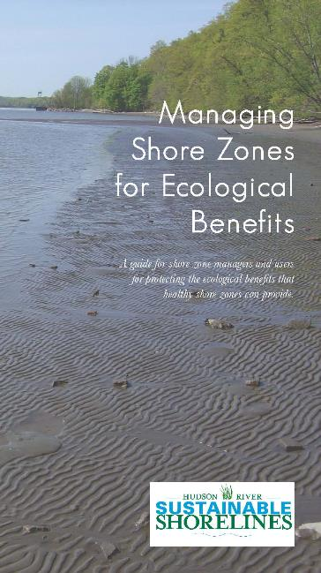
Sustainable Shorelines Project
“Promoting choices that preserve or enhance ecology and shoreline benefits while meeting upland use and engineering needs in a changing climate”.
Started in 2005
Supported research, guidance and outreach
Demonstration projects and network
Partners: NYSDEC Hudson River NERR and Hudson River Estuary Program, Cary IES, Consensus Building Institute, Steven’s Institute of Technology and many other state, local and NGOs
https://hrnerr.org/sustainable-shorelines/
Notes:
Project was a partnership with NYS Hudson River Estuary Program, Hudson River NERR, Cary Institute of Ecosystem Studies, Consensus Building Institute, Steven’s Institute and many other local, state and federal partners.
Began in 2008 and included a number of research projects, stakeholder outreach, guidance development and demonstration projects.

Slide 3
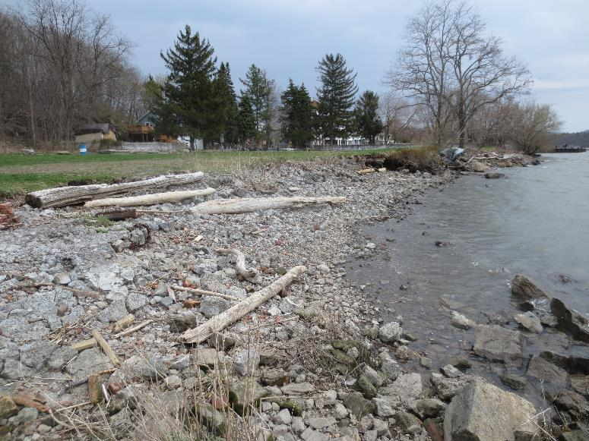
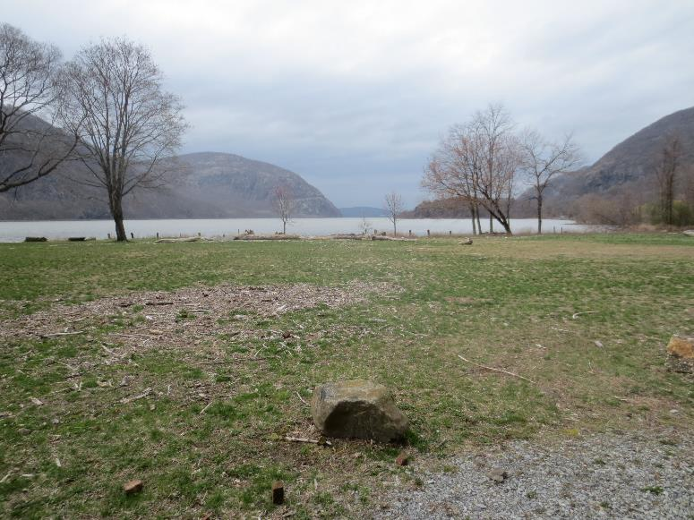
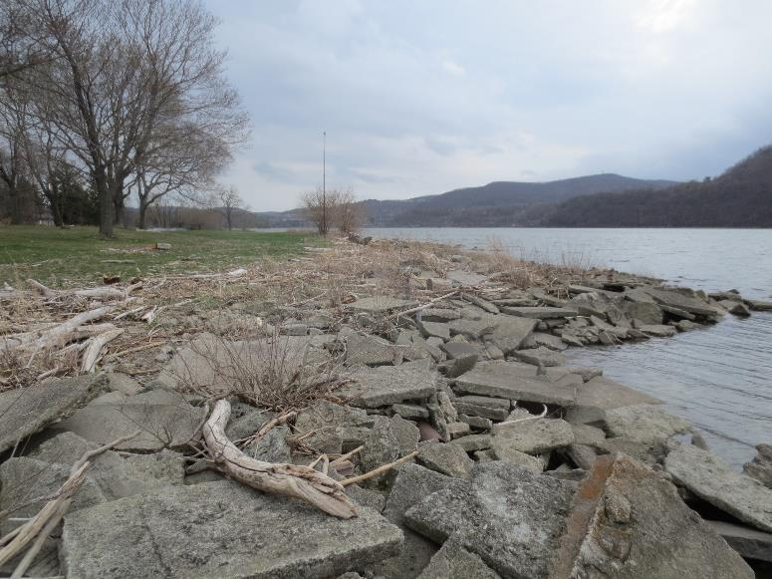
Dockside Park Site Conditions
Hudson Highlands State Park Preserve (OPRHP)
Located within and maintained by Village of Cold Spring
Popular activities include:
Extreme sightseeing!
Outdoor film series
Picnics
Music
Food trucks
Kayak launch
Dog walking
Dockside Park, Cold Spring, April 2013

Slide 4
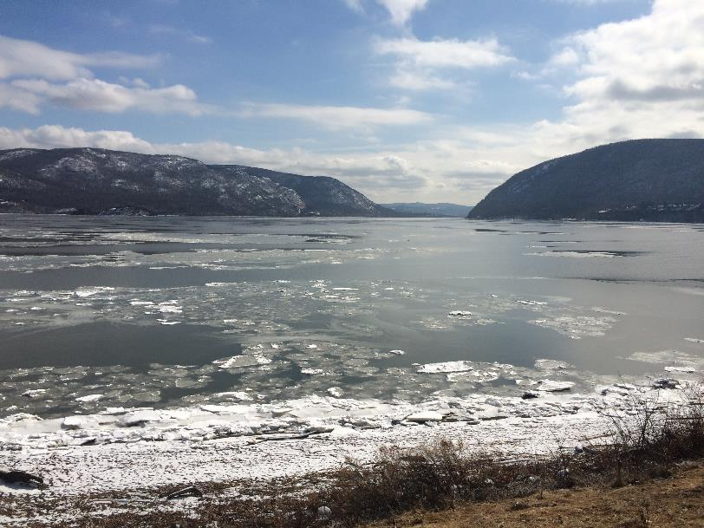
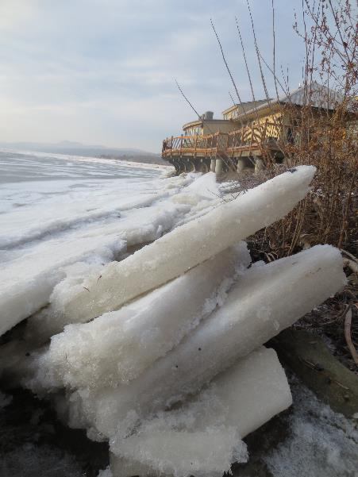
Environmental Context
Steep sided, rock framed estuary
Tidal brackish to fresh water
Wind driven waves and currents
Fill (unstable)
Industrial history
Ice scour
2014 Norrie Point ‘pancake ice’
Hudson Highlands from Plum Point

Slide 5
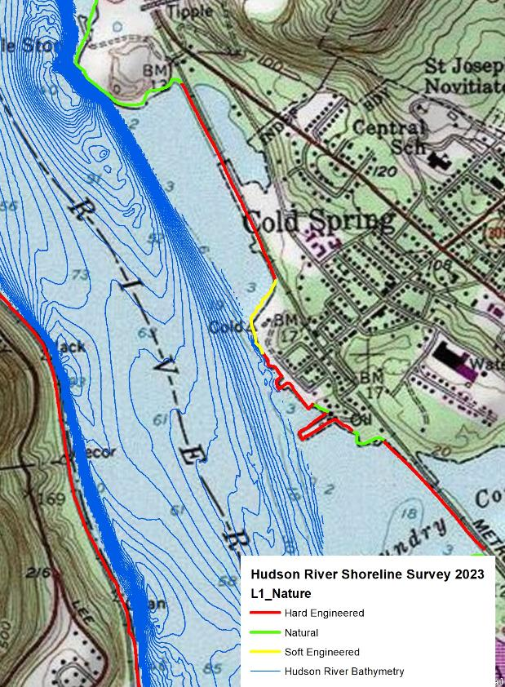
Project Strategy
Goal- Stabilize park property while integrating human use preferences with preservation or improvement of habitat value by:
Mimicking natural shorelines
Balancing human use with habitat protection and improvement.

Slide 6
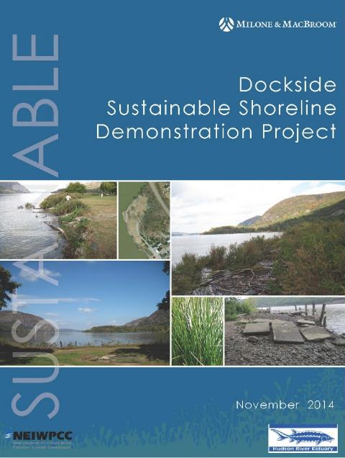
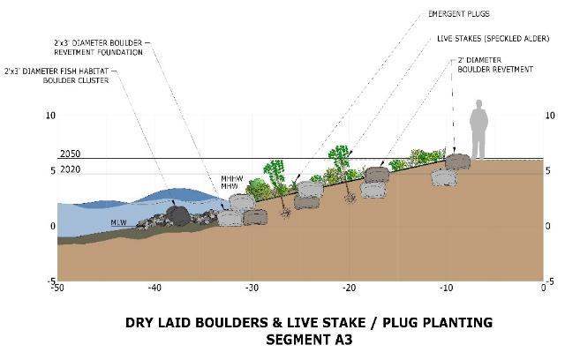
Dockside Park: Preliminary Design Project (2012)
Educate community about ecology of the Hudson and climate change impacts including sea-level rise
Identify human use priorities
Identify existing conditions
Identify shoreline stabilization options
Produce preliminary plans
Final design and construction funding was TBD

Slide 7
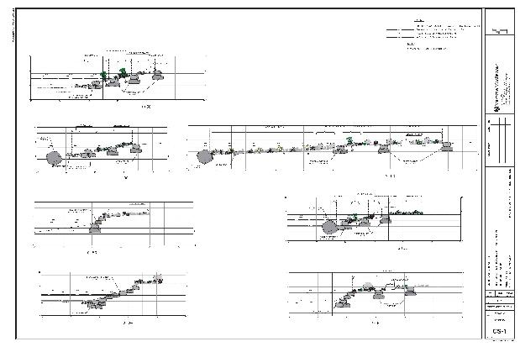
Phase II-Final Design and Construction (2020-2022)
Managed by OPRHP
Late teens- mitigation funding available
2020- OPRHP to begins final design
Spring 2022- Construction begins

Slide 8
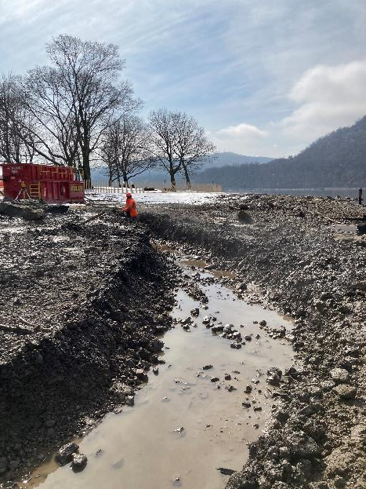
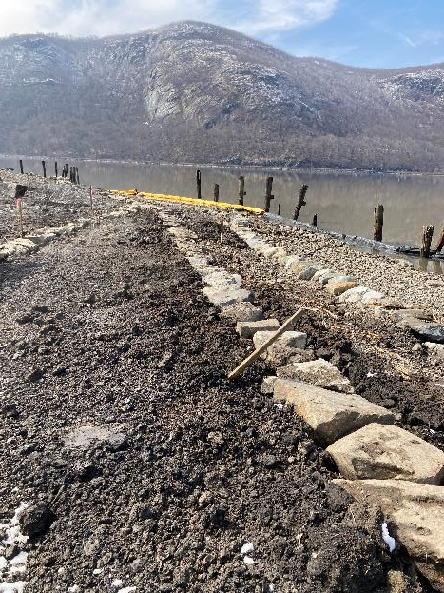
Dockside Park, Cold Spring, NY Construction 2022
Treatment varied based on condition and human use
Tiered vegetation and rock design
In-water wave and ice attenuation
May 2022

Slide 9
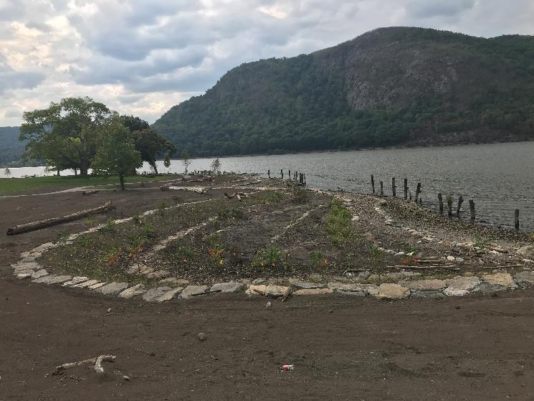
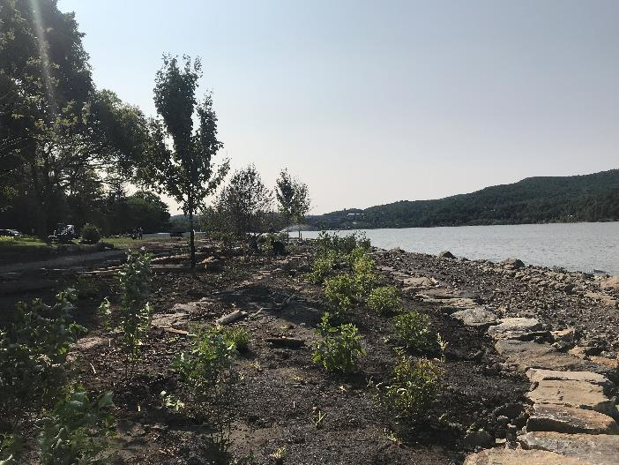
Construction Completed September 2022

Slide 10
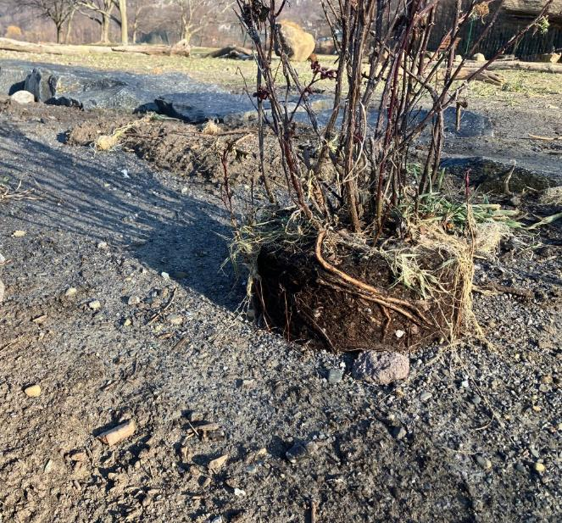
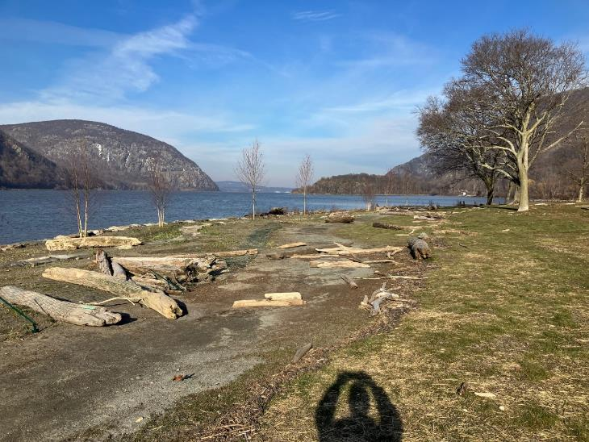
Christmas Storm December 2022
Wrack Line

Slide 11
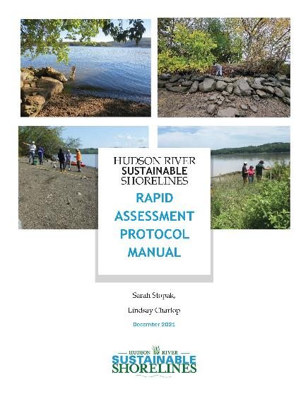
Maintenance and Monitoring
Routine maintenance
OPRHP and Village of Cold Spring
Shoreline monitoring
HRNERR Rapid Assessment
Met project goal of stabilizing shoreline utilizing methods that mimic natural shoreline in the area
Minor maintenance and cleanup reported

Slide 12
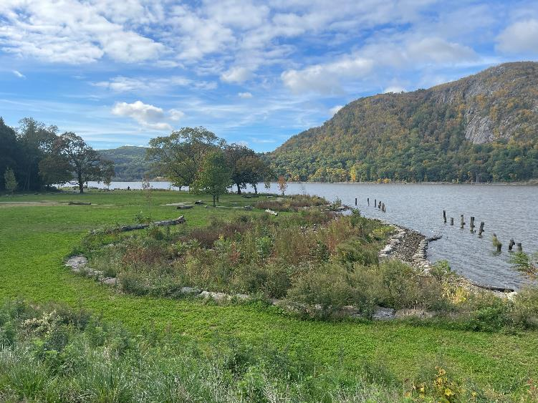
Sustainable Shorelines Demonstration Project: Lessons Learned:
Community support is essential
Avoid ‘one size fits all’ solutions
Combine ‘use’ with opportunities to protect and restore habitat
No shoreline is maintenance free
Dockside, Summer 2023

Slide 13
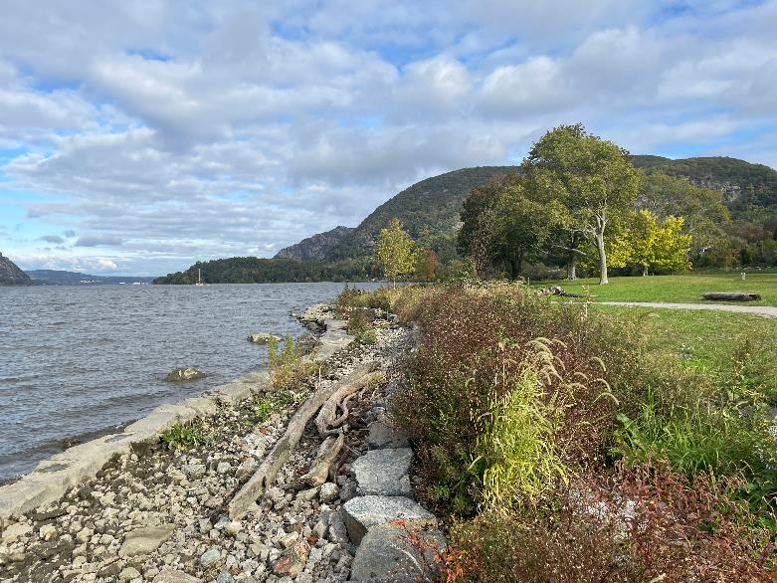
Project Partners
NYS Office of Parks, Recreation and Historic Preservation
Village of Cold Spring
NYSDEC
Milone and MacBroom and SLR Engineering
Dockside, Summer 2023

Slide 14
Thank You
Daniel Miller
Hudson River Estuary Program
Habitat Restoration Coordinator
P.O. Box 315, Staatsburg, NY 12580
Email: Daniel.miller@dec.ny.gov
Office: (845) 889-4745 ext. 110
Connect with us: Facebook: www.facebook.com/NYSDEC Twitter: twitter.com/NYSDEC Flickr: www.flickr.com/photos/nysdec

