Slide 1
Cultivating Equitable Collaboration for Natural Infrastructure Planning
Donald R. Nelson
dnelson@uga.edu

Slide 2
Collaborators
Janaki M., UGA Anthropology
S. Kyle McKay, Ph.D., P.E., Environmental Laboratory, USACE
Gabrielle Langhorn, UGA Anthropology
Jonathan Hallemeier, Environmental Laboratory USACE
Brian Zettle, USACE, TNTCX
Mark Gilfillan, Sac and Fox Nation of Missouri Tribal member, USACE, TNTCX
Aubrey Harris, Environmental Laboratory, USACE
Ann Strange, USACE, TNTCX
Arianna Kitchens, USACE, TNTCX

Slide 3
Equity Tree
Seigerman et al. 2023

Slide 4
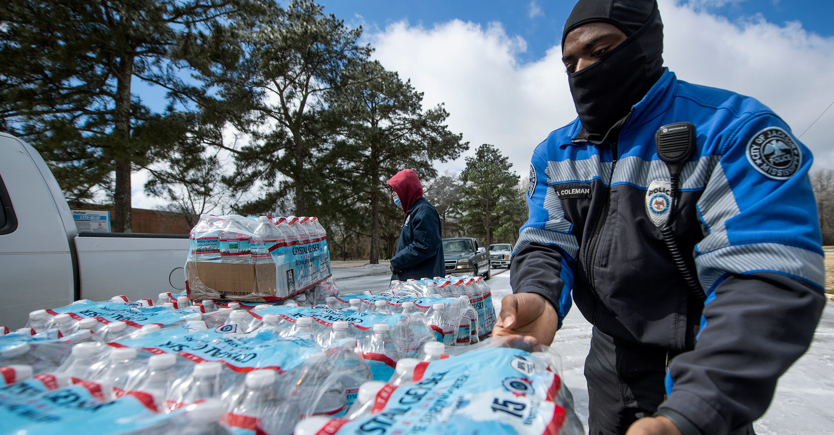
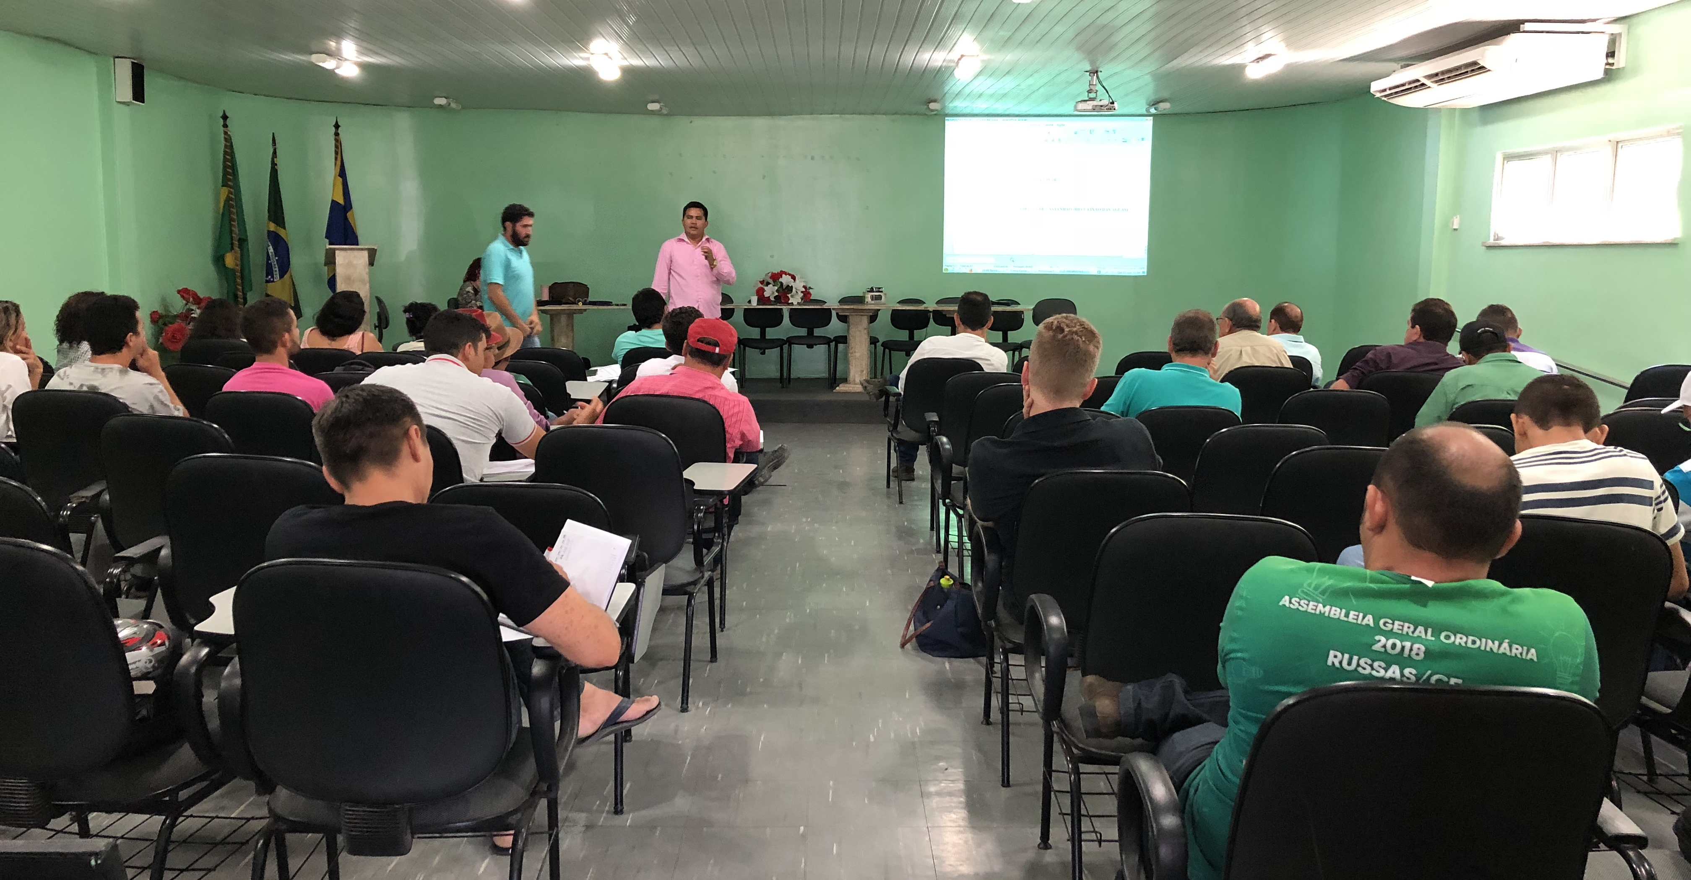
Who’s data, who’s knowledge?
https://www.clarionledger.com/
Benefit-Cost ratios rarely demonstrate benefit in protecting water quality
“The water that we make”
Observations → Selecting data → Making meaning

Slide 5
Necessary for sustainability
Strengthen cultures of innovation
↑ numbers = ↑ possibility of new combinations
Move beyond single problem solutions

Slide 6
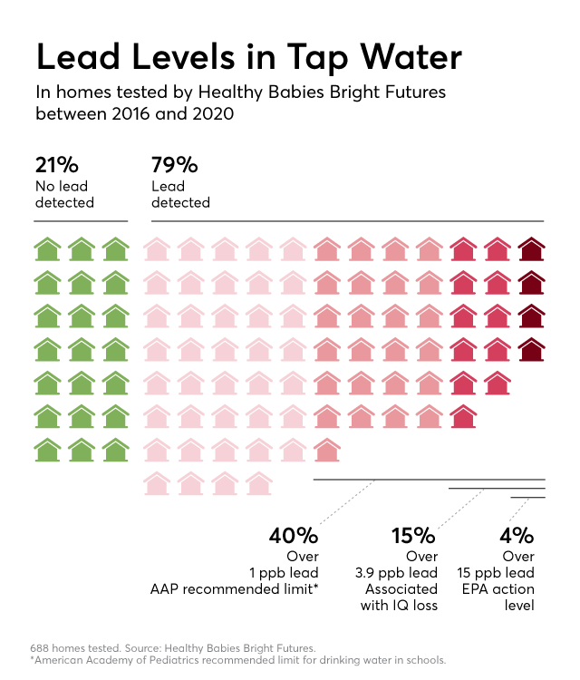
Challenges:
Go from passive agreement to doing
Incorporate knowledges
Tangible
Intangible
Aspirational/Futures
Willingness!!!
Notes:
McPhearson et al. 2022

