Slide 1
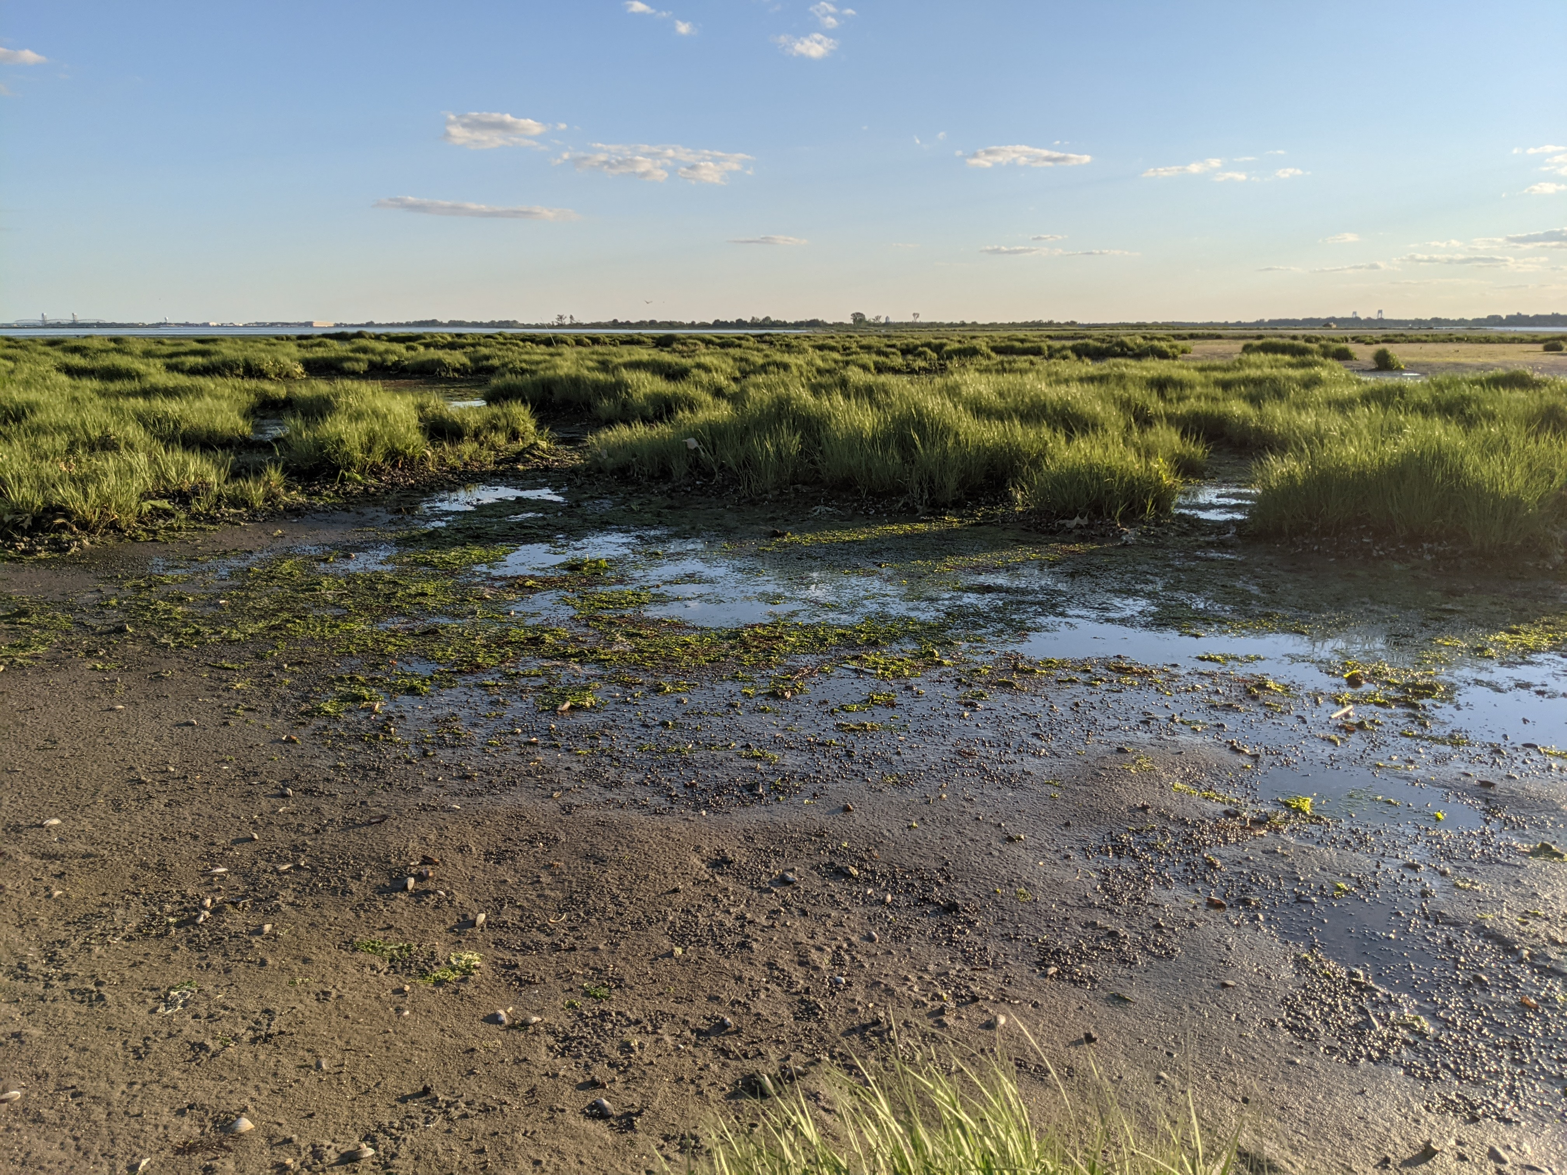

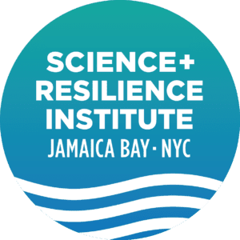


Nature-based approaches for improving water quality
Chester Zarnoch
Baruch College and Graduate Center
City University of New York
Science and Resilience Institute
Notes:
Provide a concise summary of your research on the effectiveness of a specific NNBF project or projects
How was the effectiveness assessed?
Were there specific performance targets or baseline for comparison?
What were the results?

Slide 2
Nature-based solutions (ecological engineering) can improve water quality
Duarte and Krause-Jensen 2018
Emission of Reactive N as N₂
Ecological Engineering
- Enhance 3-D habitats
Hydrological Engineering
Nutrient Inputs
Nutrient Concentration
Nutrient Outputs
Ecological Engineering
- Aquaculture
Nutrient Burial
Ecological Engineering
- Enhance 3-D habitats
Geological Engineering
- Lock Nutrients in Sediment

Slide 3
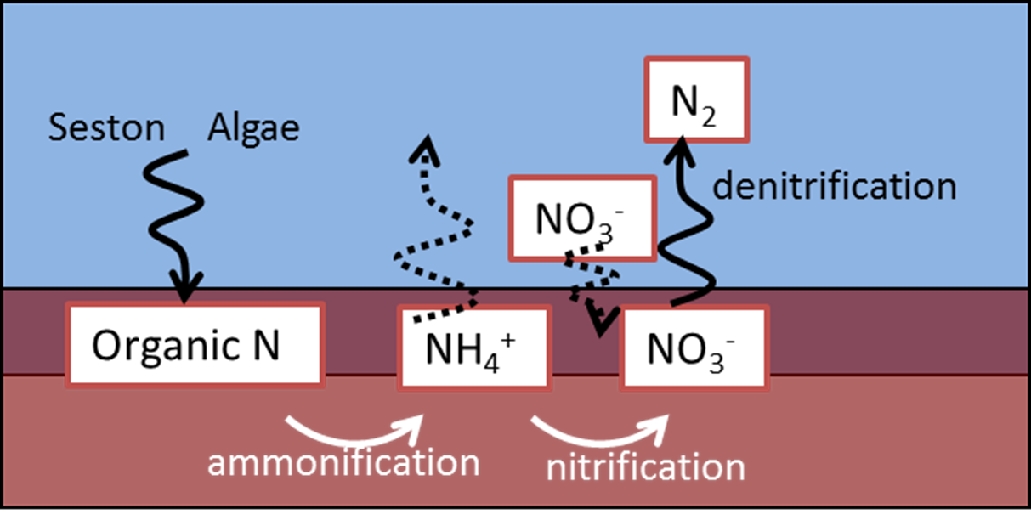
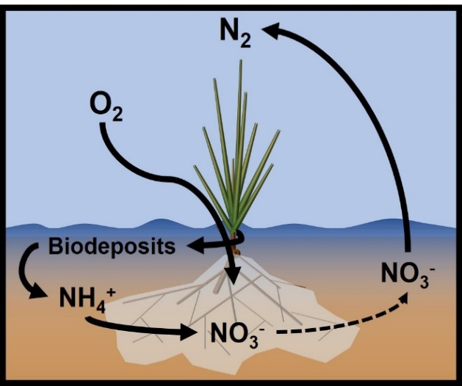
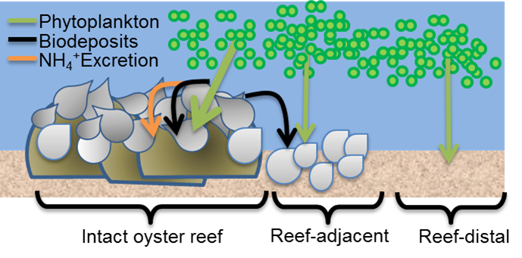
Coastal habitats can enhance denitrification by alleviating limitations
Denitrification requires:
Source of NO₃⁻
Organic carbon
Anaerobic conditions

Slide 4
Oysters can enhance nitrogen removal
Sediment microbes
Ayvazian et al. 2021 – Environmental Science and Technology

Slide 5
Oysters can enhance nitrogen removal
Oyster microbes
Ayvazian et al. 2021– Environmental Science and Technology

Slide 6
Ecological Engineering is being implemented as a tool for nutrient mitigation
Chesapeake Bay Partnership has given preliminary approval for enhanced denitrification from oyster restoration as a tool for municipalities to achieve TMDL requirements.
Several towns on Cape Cod are in final stages of study and policy development for enhanced denitrification to be used for TMDL.
Enhanced Denitrification = Restored Habitat Denitrification – Baseline Denitrification

Slide 7
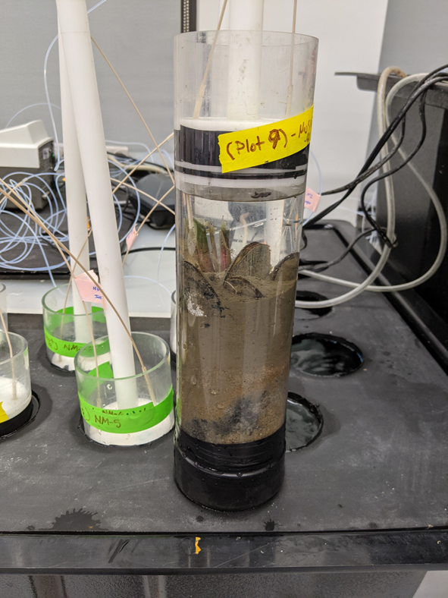
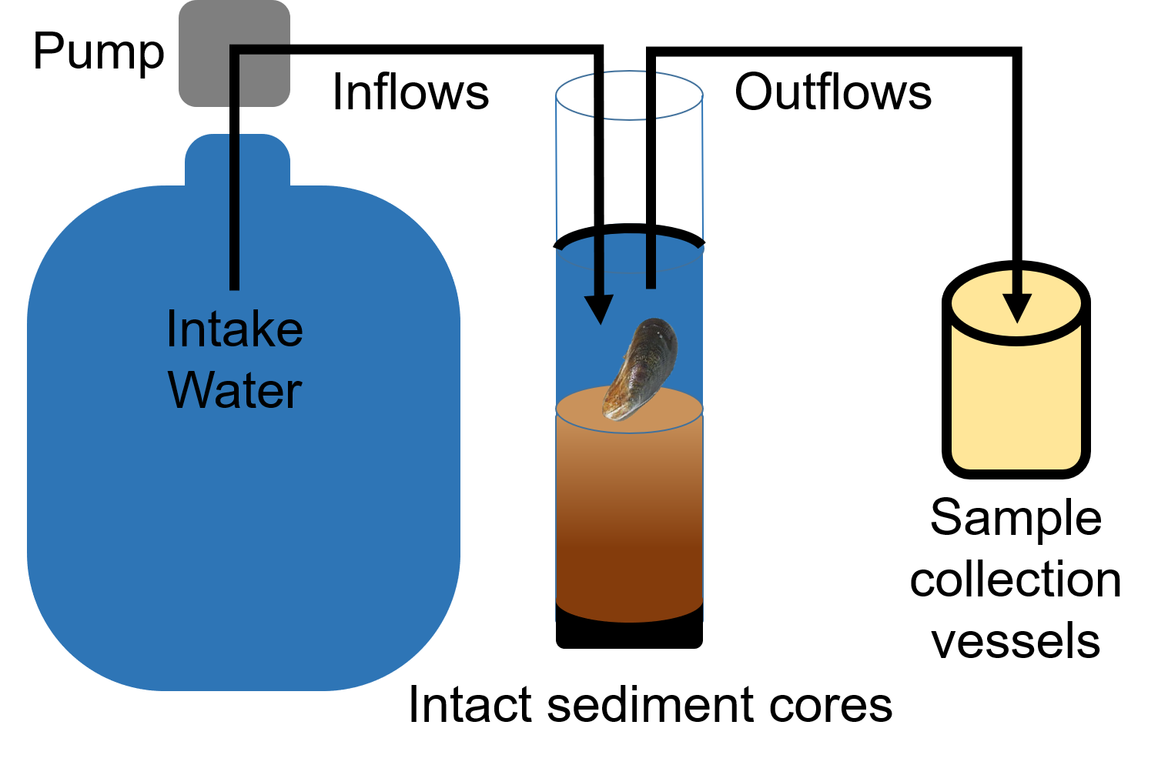
Measuring N removal processes
Continuous–flow core incubations

Slide 8
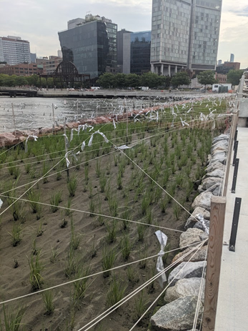
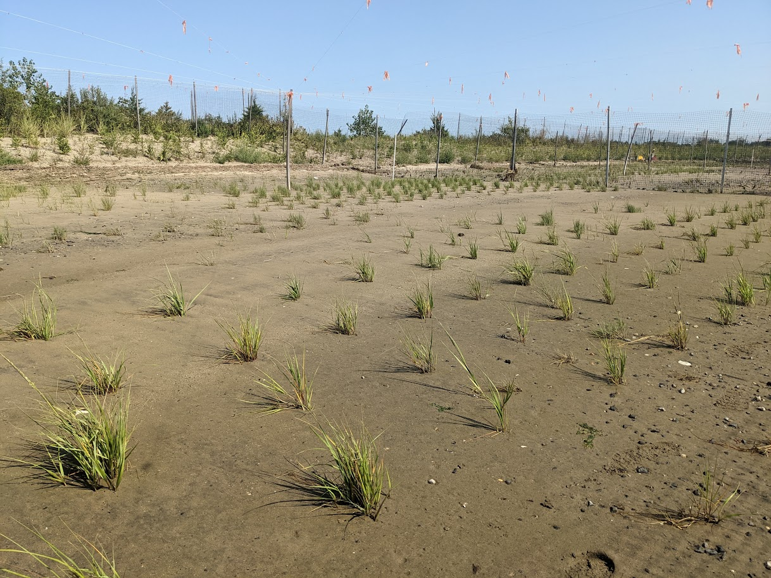
Salt marsh restoration includes Spartina but not ribbed mussels

Slide 9
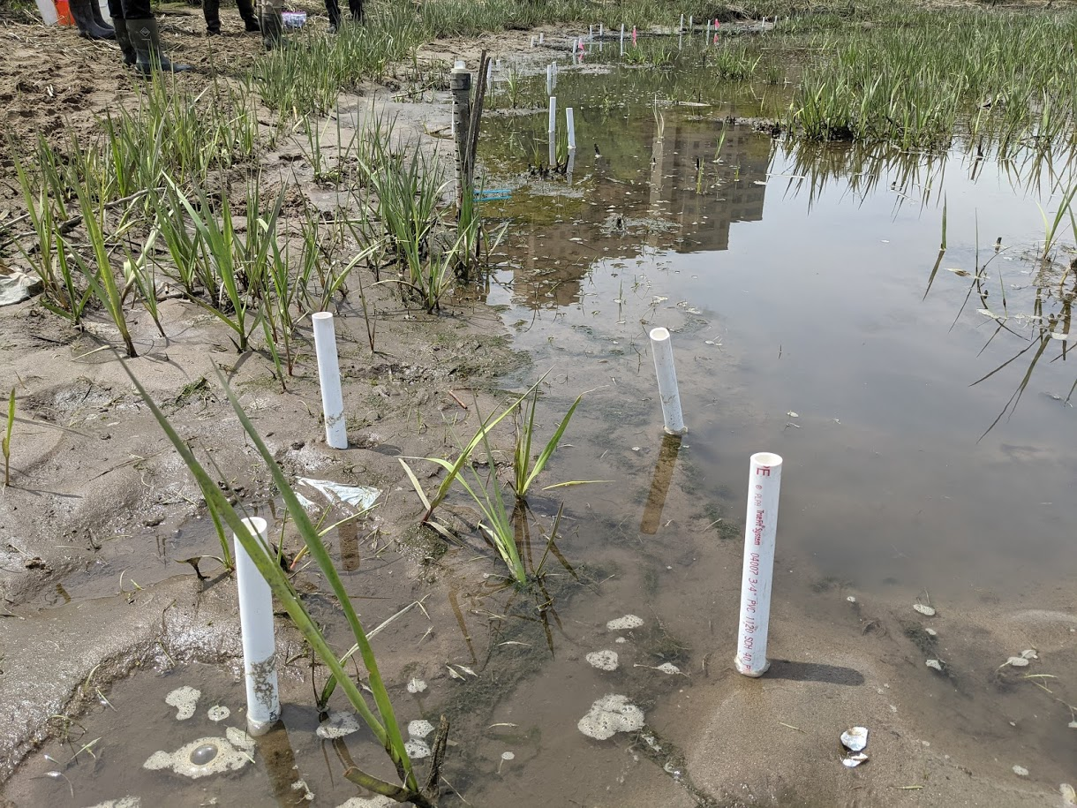
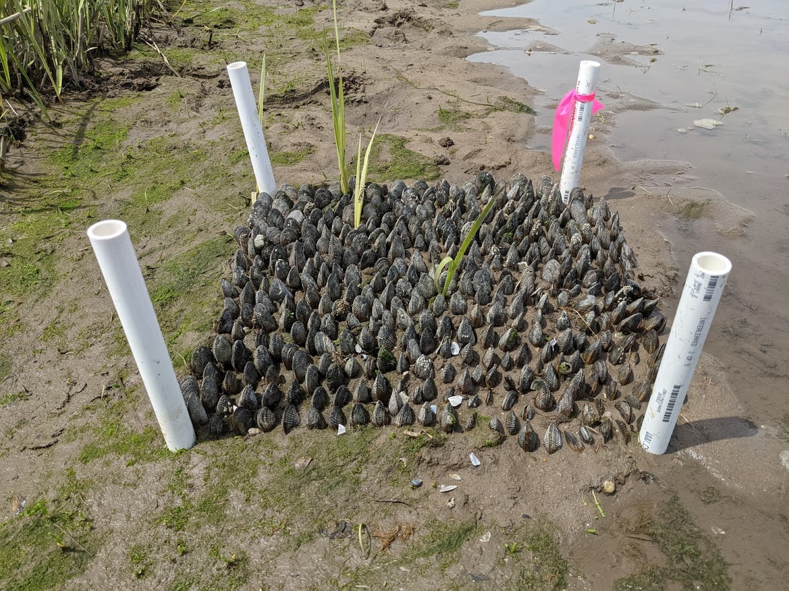

Slide 10
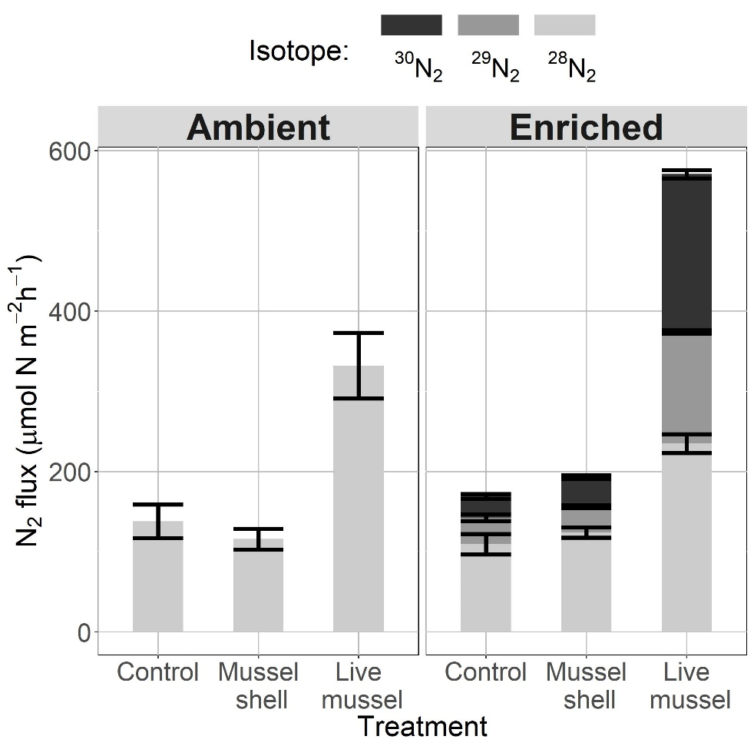
Ribbed mussels increase nitrogen removal via denitrification
Zhu et al. 2019 Marine Ecology Progress Series

Slide 11
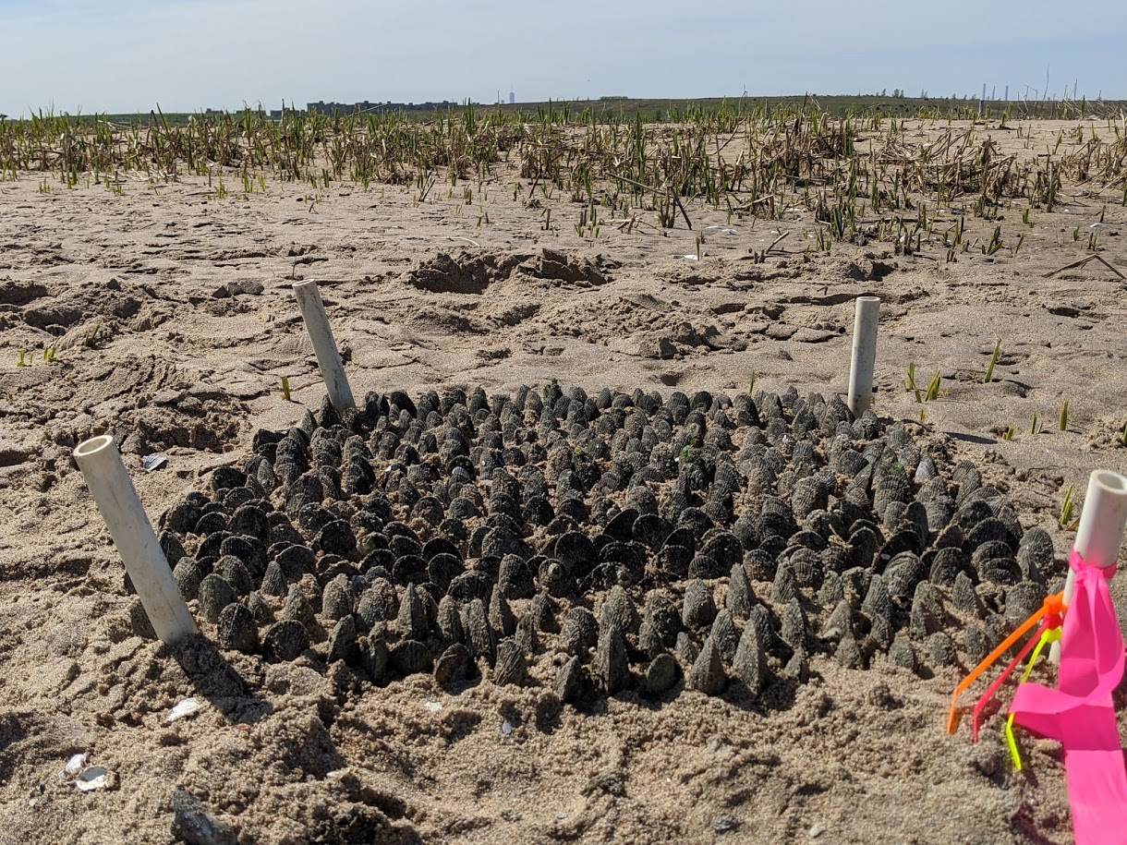
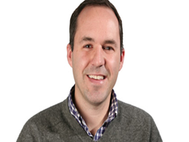

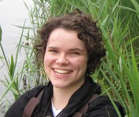

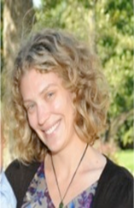
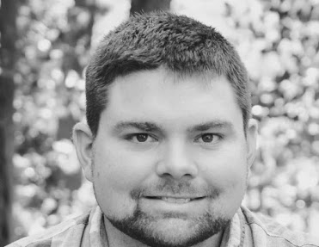
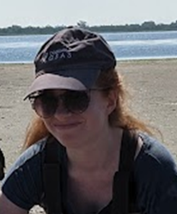
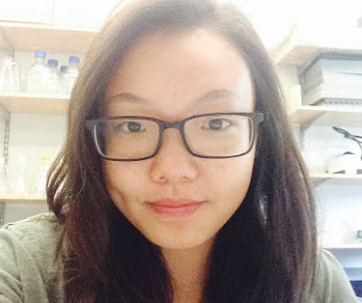

Funding:
Hudson River Foundation
NY Water Resources Institute
Mary Alldred, Ph.D.
SUNY Plattsburgh
Denise Bruesewitz, Ph.D.
Colby College
Stephen Gosnell
Baruch College & CUNY Graduate Center
Beryl Kahn
CUNY Graduate Center

Slide 12
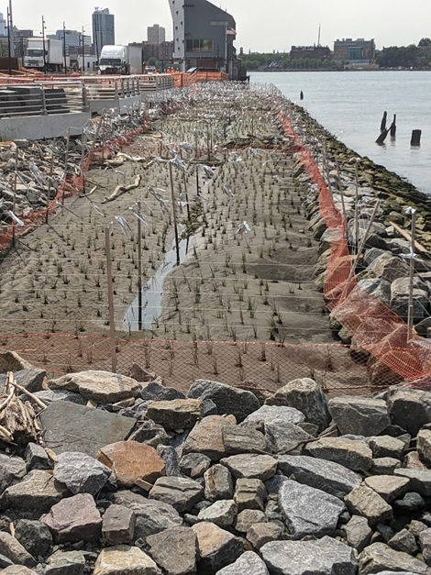
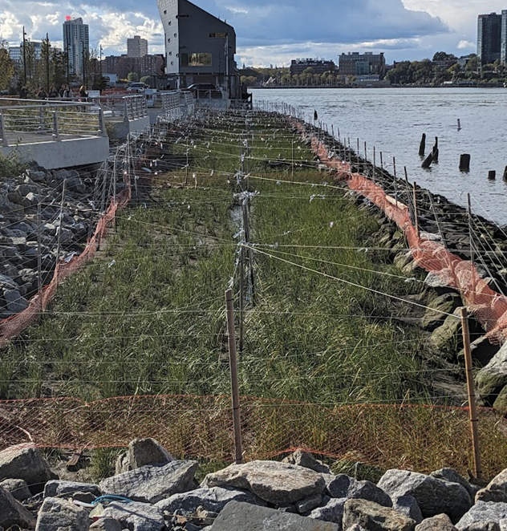
Gansevoort Peninsula Salt Marsh
June 2023
October 2023

Slide 13

Gansevoort Peninsula Salt Marsh
Nitrogen Removal
Treatments
1) No Spartina
2) Short form
3) Tall form
Other Natural Marshes

