Slide 1
Alabama Comprehensive Living Shoreline Monitoring Program
Bret Webb, Ph.D., P.E., BC.CE
Professor of Coastal Engineering
Department of Civil, Coastal, & Environmental Eng.
December 14, 2023
NY Sea Grant NNBF Virtual Forum II
Lightning Talk

Slide 2
Acknowledgments Dr. Nigel Temple, Deborah Fernandes, Kate Richards, Tabassum Islam Dr. Ronnie Baker, Alex Rodriguez, Aaron Bland Dr. Amy Hunter, Dr. Rita Peachey, Camille Covington Funding for this project is provided by the Gulf Coast Ecosystem Restoration Council (RESTORE Council) and the Alabama Department of Conservation and Natural Resources (ADCNR). The presentation and all associated data and related items of information were prepared by the University of South Alabama under award no. GT1CP21AL0001-01 from the RESTORE Council and ADCNR. The data, statements, findings, conclusions, and recommendations are those of the author(s) and do not necessarily reflect any determination, views or policies of the RESTORE Council or ADCNR.

Slide 3
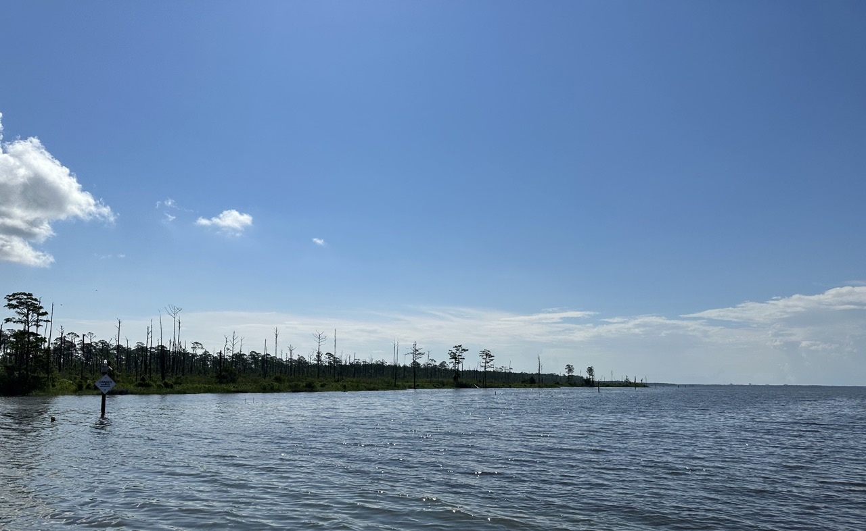
Lightning Strikes
01
02
03
04
Project Overview
Overarching Goals
Monitoring Overview
Expected Outcomes

Slide 4
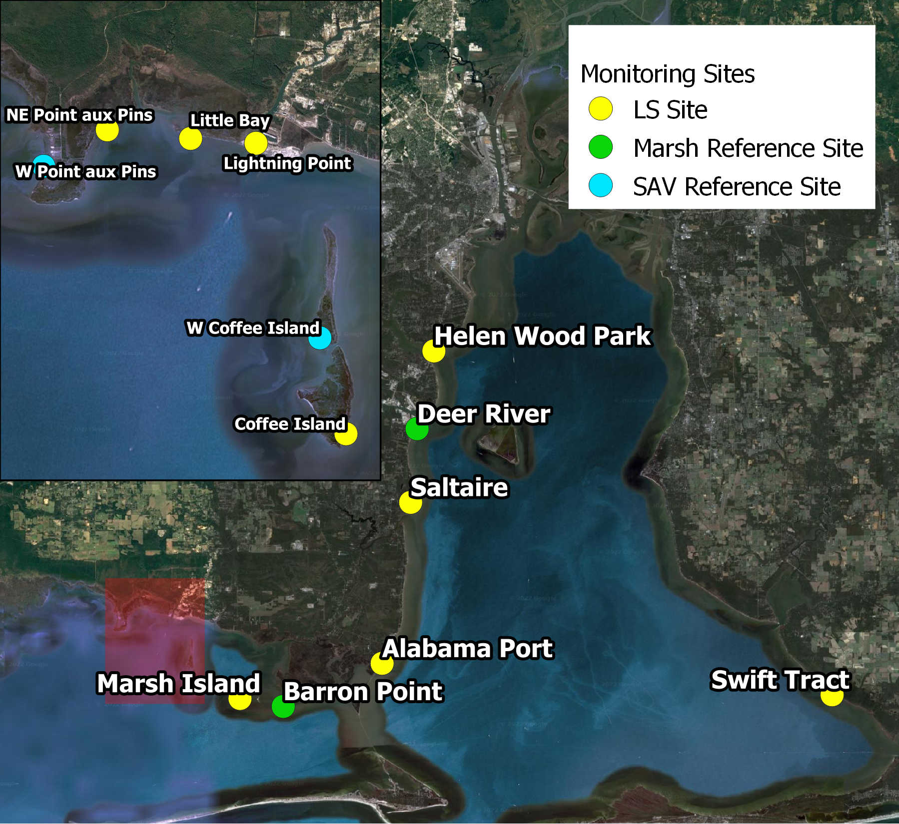
01 Project Overview
Living Shoreline Monitoring
Coastal Alabama
Funded by RESTORE Act
5-year period of performance
9 project locations + controls
2 marsh reference sites
2 SAV reference sites
Variety of age, wave exposure, salinity regime, treatment/design, etc.
Some preliminary monitoring data

Slide 5
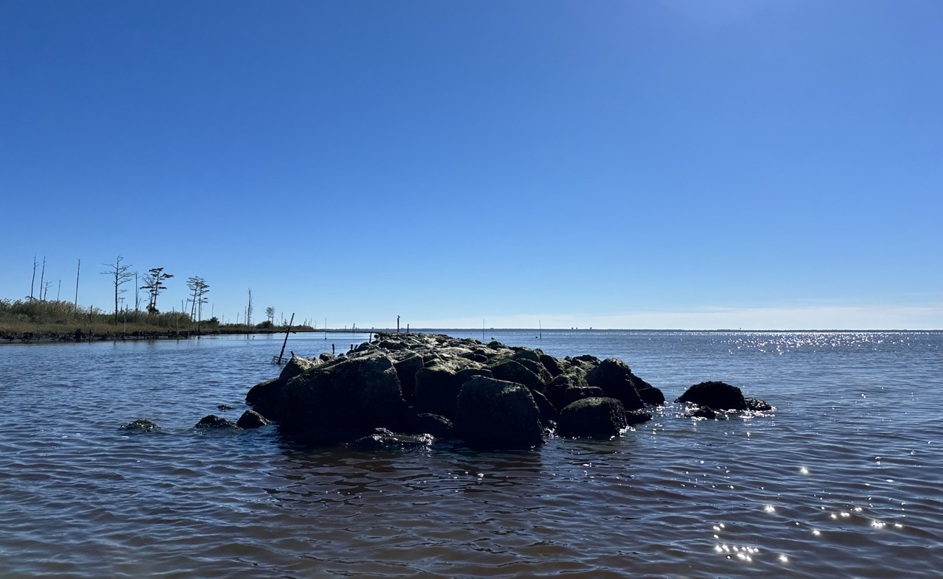
02 Overarching Goals
#1
Evaluate existing project performance relative to shoreline stability and ecosystem health
#2
Develop and test standard monitoring protocols for future projects

Slide 6
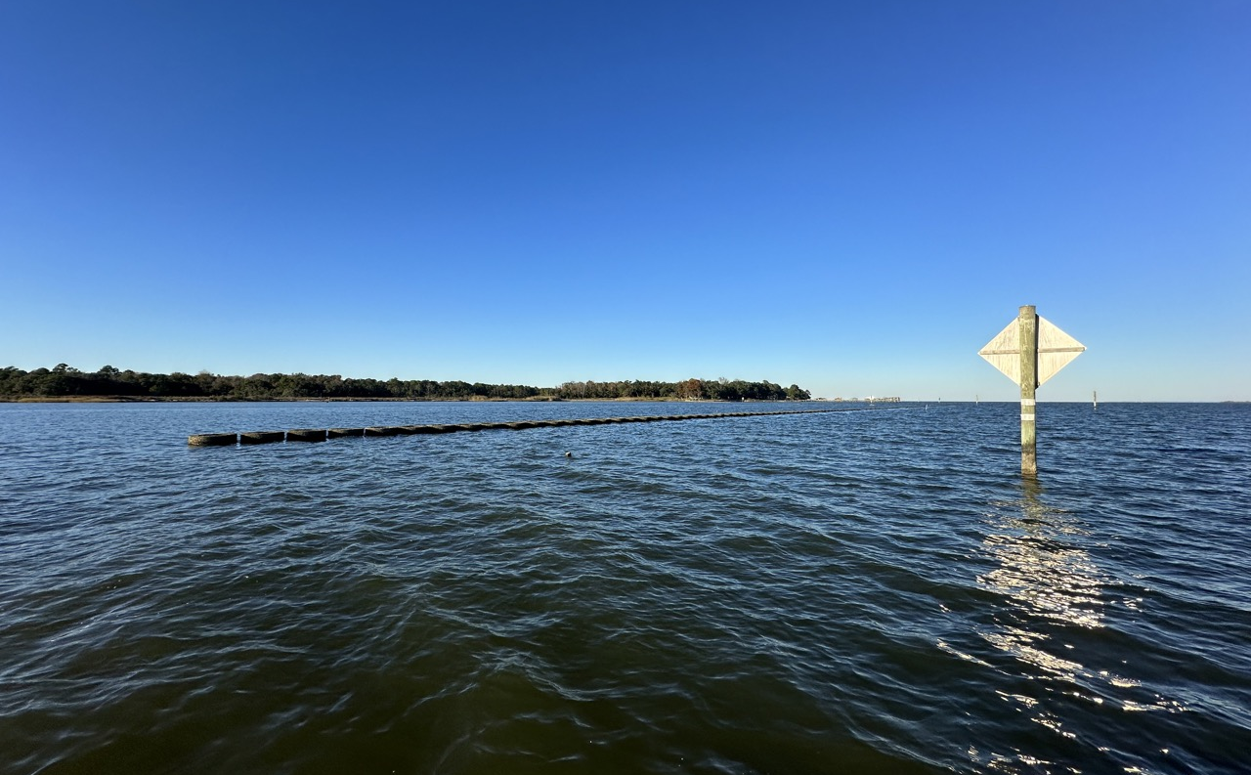
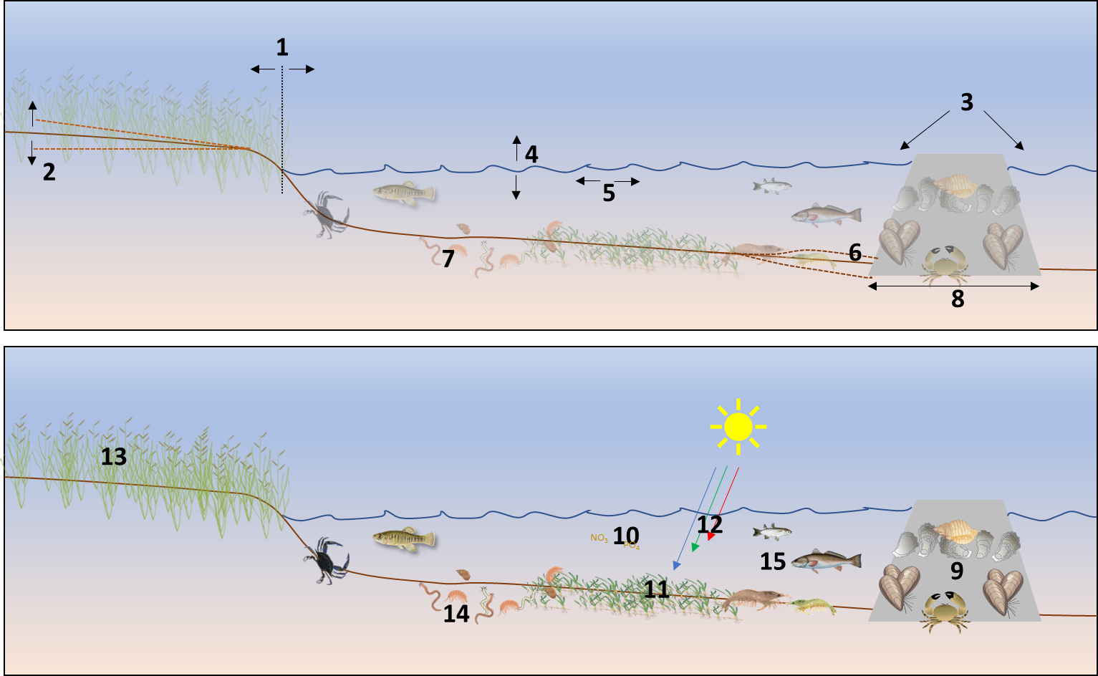
03 Monitoring Overview
Shoreline Position
Intertidal Elevation
Wave Energy
Water Level
Currents
Bathymetry
Sediment
Reef Footprint
Encrusting Fauna
Water Quality
SAV Coverage
Light Environment
Wetland Vegetation
Benthic Infauna
Nekton

Slide 7
03 Monitoring Overview
Shoreline Position
Intertidal Elevation
Wave Energy
Water Level
Currents
Bathymetry
Sediment
Reef Footprint
Encrusting Fauna
Water Quality
SAV Coverage
Light Environment
Wetland Vegetation
Benthic Infauna
Nekton
Coffee Island
Little Bay
Marsh Island
Helen Wood Park
Lightning Point
Alabama Port
NE Point aux Pins
Saltaire
Swift Tract

Slide 8
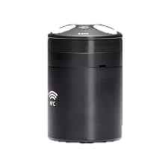
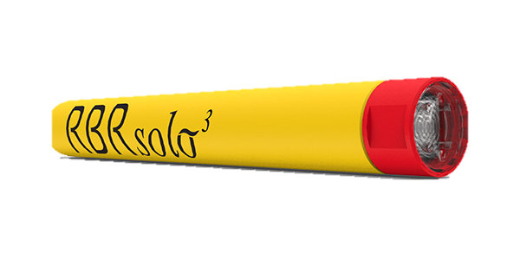
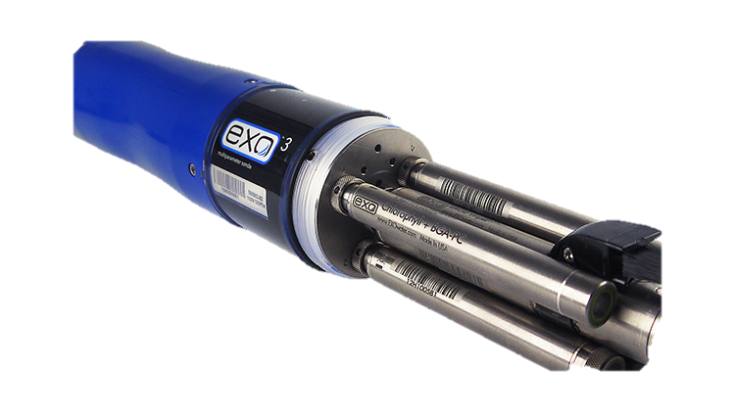
03 Monitoring Overview
Nortek ECO ADCP
RBR Solo D|Fast
SediMeter
Shoreline Position
Intertidal Elevation
Wave Energy
Water Level
Currents
Bathymetry
Sediment
Reef Footprint
Encrusting Fauna
Water Quality
SAV Coverage
Light Environment
Wetland Vegetation
Benthic Infauna
Nekton
[3,4]
[4,5]
Temperature
Conductivity
pH/ORP
Dissolved Oxygen
Turbidity
YSI Exo3
[10,12]
[6,12]

Slide 9
03 Monitoring Overview
shoreline
ECO
RBR
SediMeter
ECO
RBR
SediMeter
YSI
reference site
reef/breakwater
ECO
RBR
SediMeter

Slide 10
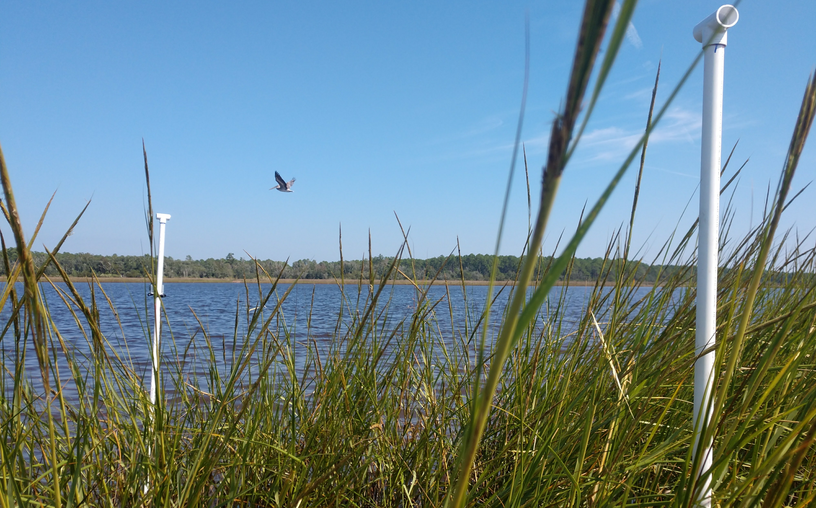
04 Expected Outcomes
What should we measure?
How should it be measured?
How do we define success?
Measure
Monitoring Protocols
Improve
Better Projects
Evaluate
Assess Performance

