Slide 1
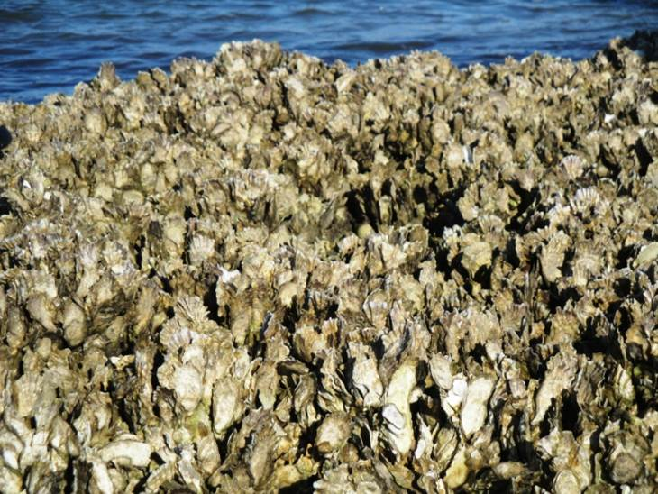
Integrating oyster natural history and fish-habitat relationships in living shoreline designs
USCRP
December 14, 2023

Slide 2
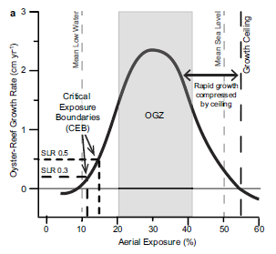
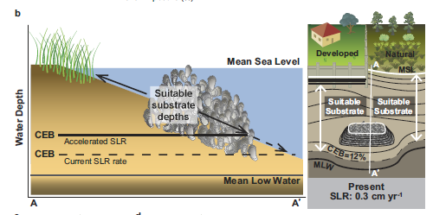
How to best integrate/leverage oyster-reef ecology into the design of living shorelines

Slide 3
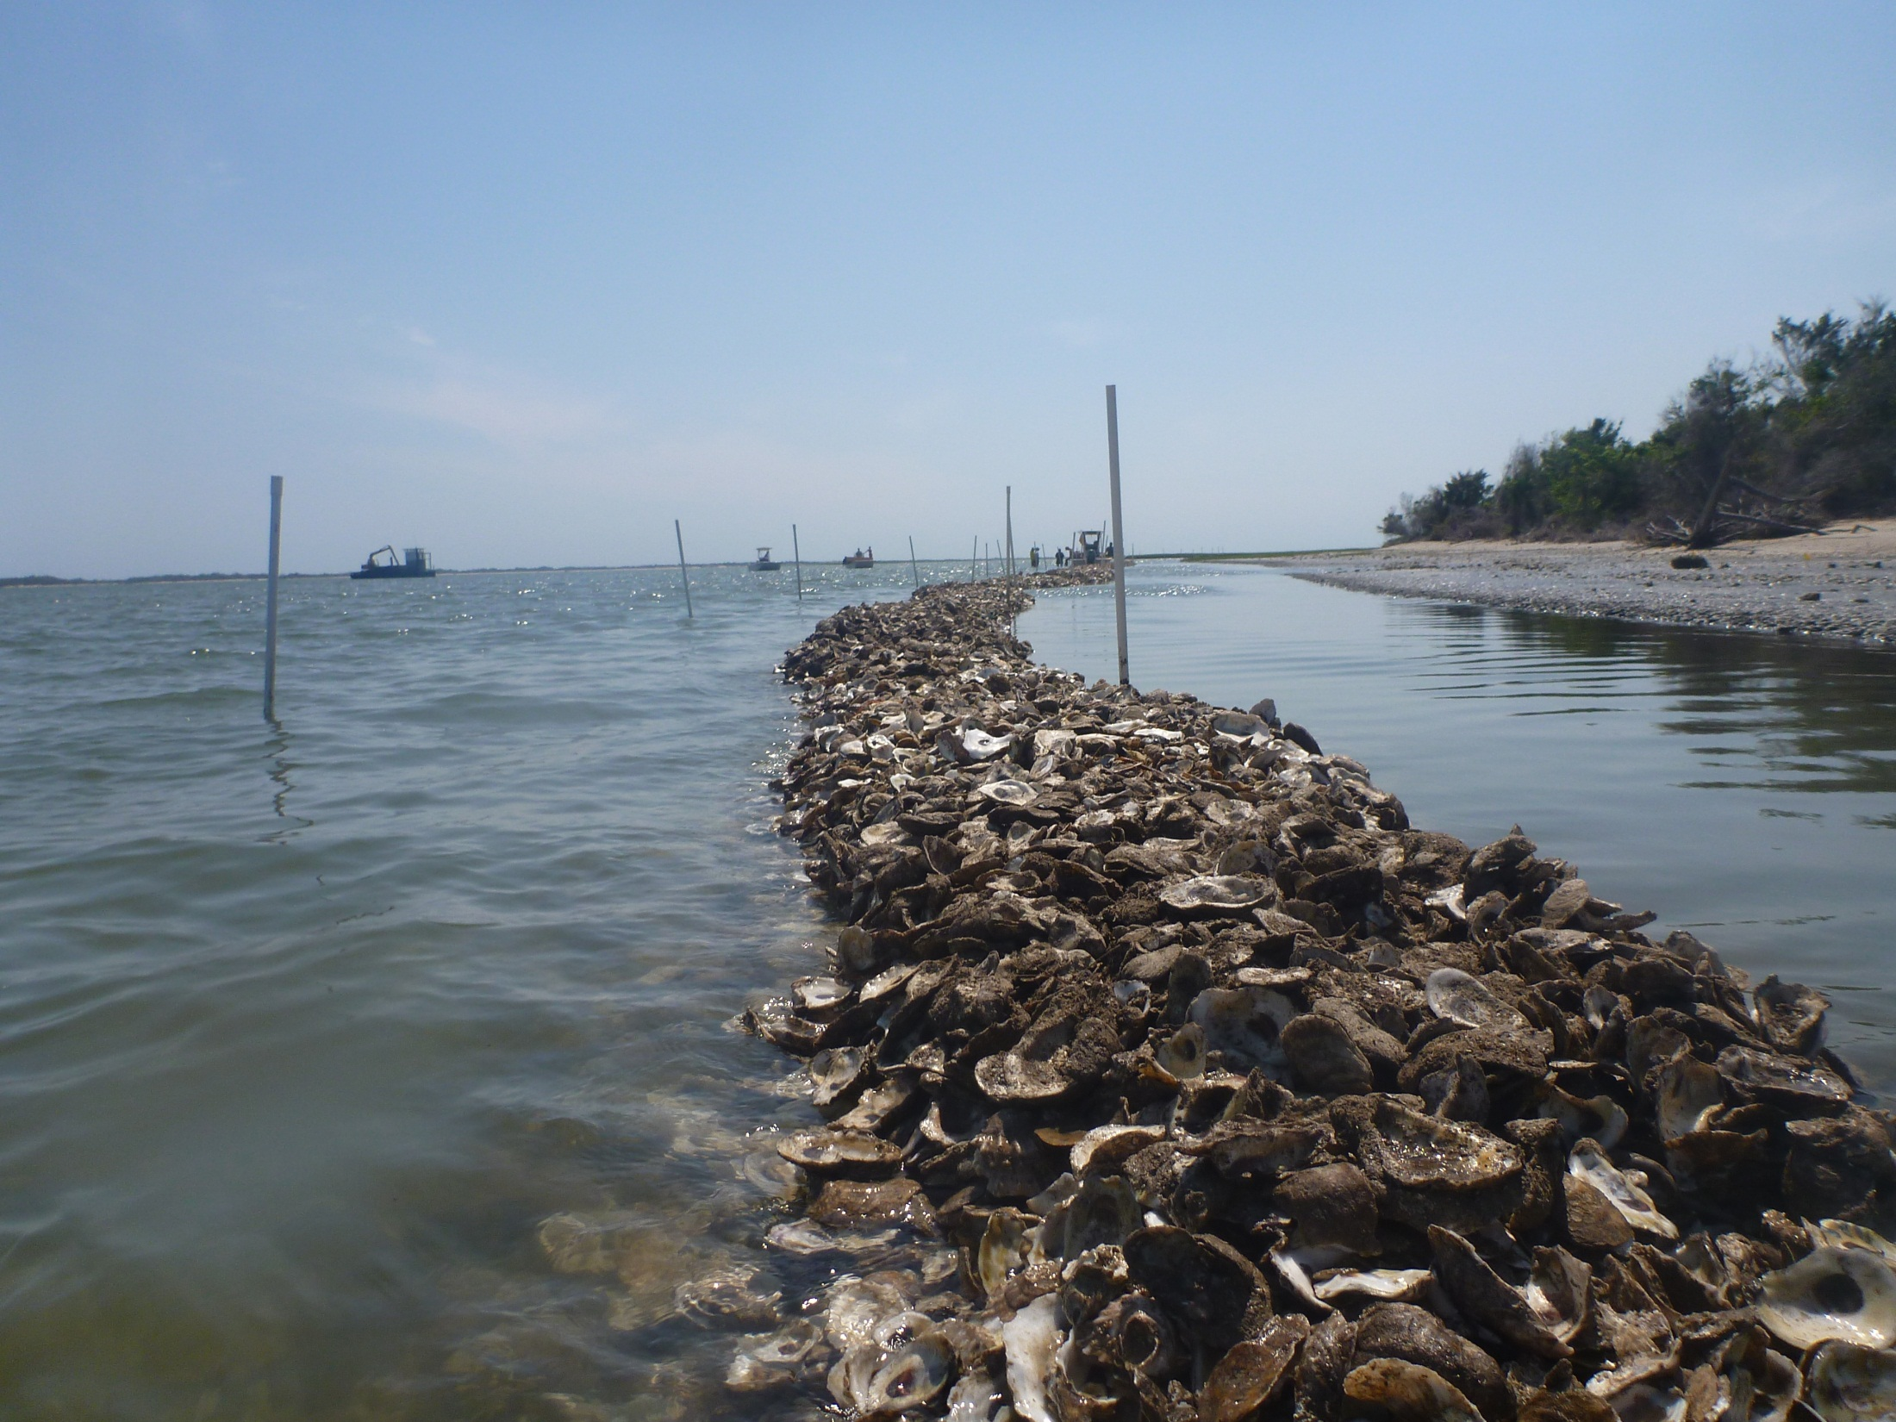
How to best integrate/leverage oyster-reef ecology into the design of living shorelines
Reef typically grow as groins, not sills!
Grave (1904)

Slide 4

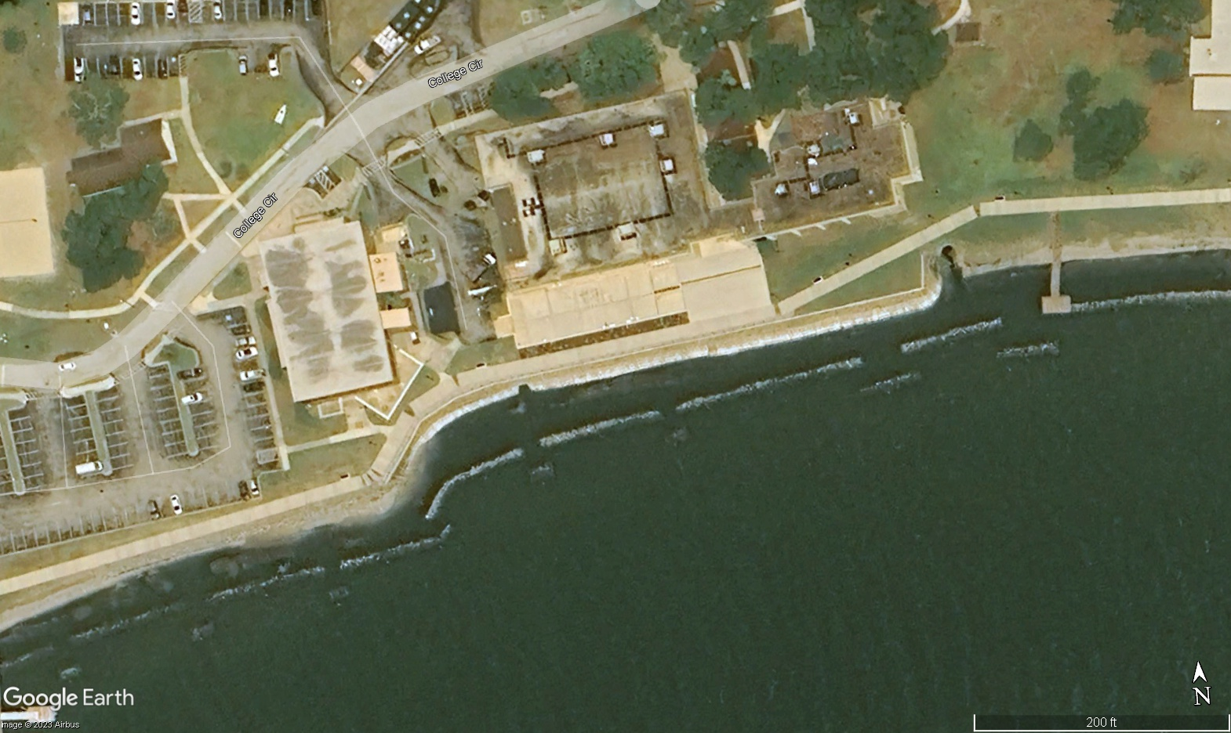
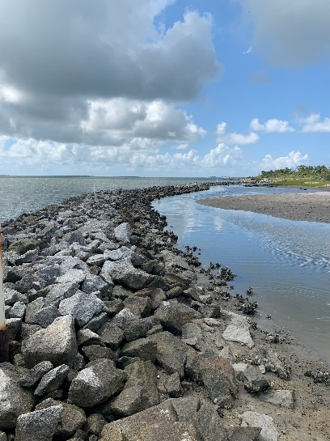
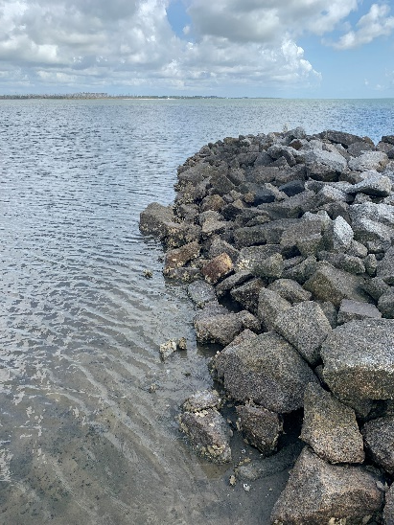
Investigating oyster-reef morphodynamics to optimize nature-based infrastructure
Landward
Landward
Seaward
Seaward
What are the patterns of oyster settlement, growth and survival on seaward, landward, and “shoulders” of sill structures?

Slide 5
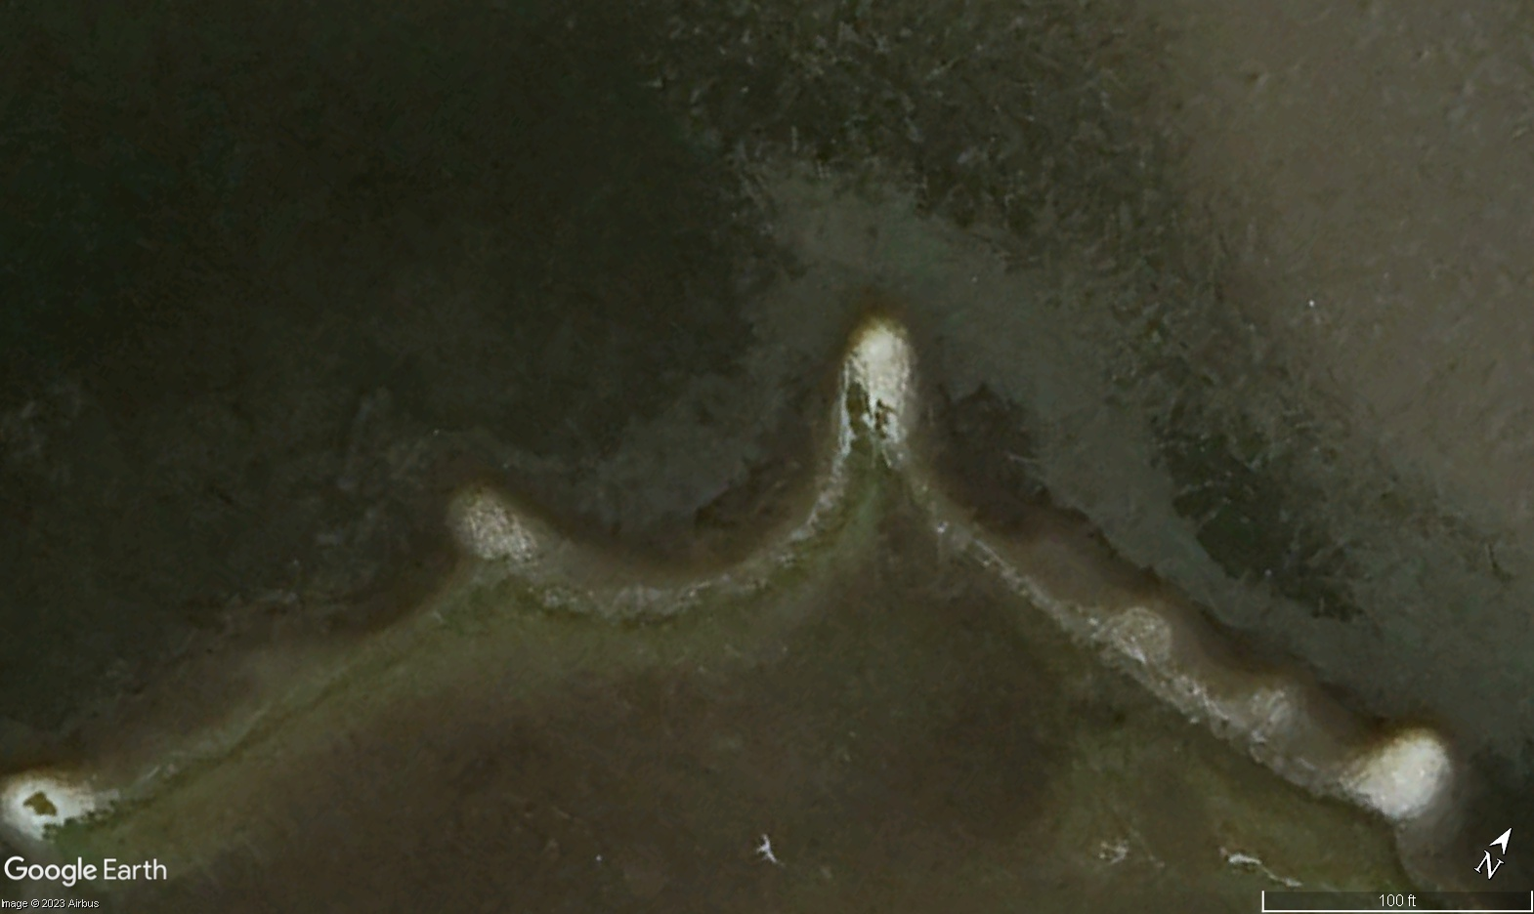
Investigating oyster-reef morphodynamics to optimize nature-based infrastructure
What are the patterns of oyster settlement, growth and survival around perimeter of natural reefs (along on seaward-landward axis)?

Slide 7
But these data (as with many others) focuses on or integrates small – typically juvenile – nekton. What about the bigger mobile fishes and inverts?

Slide 8
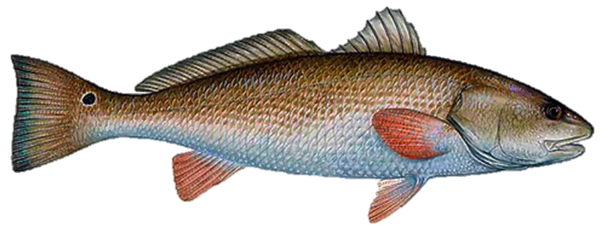
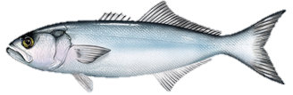
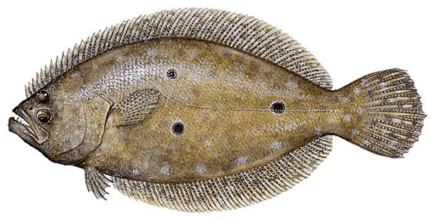
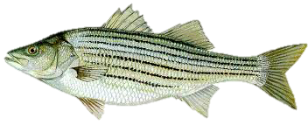
Many marsh-transient predators (large and mobile) need access to marsh at high tide for foraging

Slide 9
Some living shoreline projects do have the potential to sever seaward-landward connectivity… (?)

Slide 10
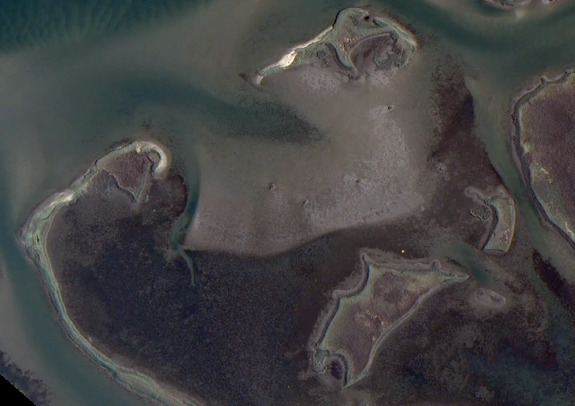
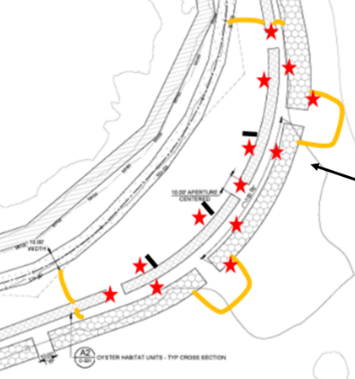
Do living shorelines effectively maintain marine faunal connectivity and diversity in intertidal landscapes?
An acoustic tagging/tracking approach.
Gray box = sill.
Star = hydrophones.
Orange lines =
blocking nets. Black bars = sensor
blockers.

