Slide 1
Observations of Wave Damping by an Array of Reef Balls in the Inter-Tidal Zone: a Preliminary Assessment
James O’Donnell^{1,2}, Amin Ilia^{1,2}, John Speers¹, Mary M. Howard Strobel¹, Jennifer O’Donnell¹, and Chang Liu²
¹Department of Marine Sciences
²Connecticut Institute for Resilience and Climate Adaptation
University of Connecticut
This work was supported by NOAA Regional Resilience Grant Program
and the US Department of Housing and Urban Development (Community Block Grant National Disaster Recovery Program), administered by the State of Connecticut, Department of Housing, UCONN, and CIRCA

Slide 2
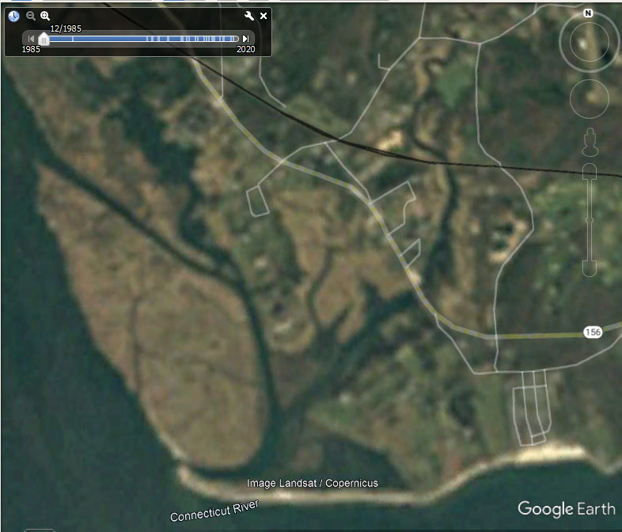
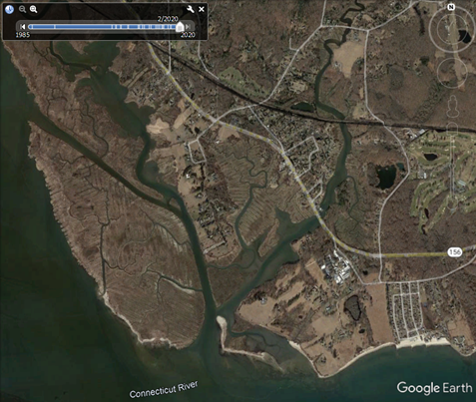
Figure 1: 1985 and 2020

Slide 3
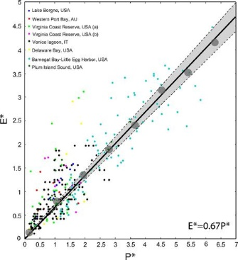

Leonardi, N., N. K. Ganju, and S. Fagherazzi (2016), A linear relationship between wave power and erosion determines salt-marsh resilience to violent storms and hurricanes, Proc. Natl. Acad. Sci., 113(1), 64–68.
($P=ρgH_{s}^{2}/8$ $\sqrt{gd}$/2 )

Slide 4
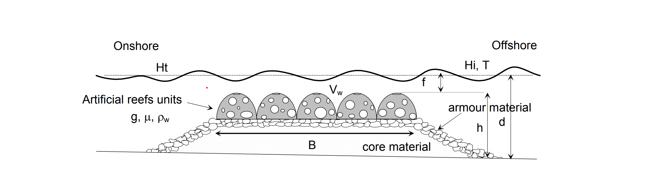
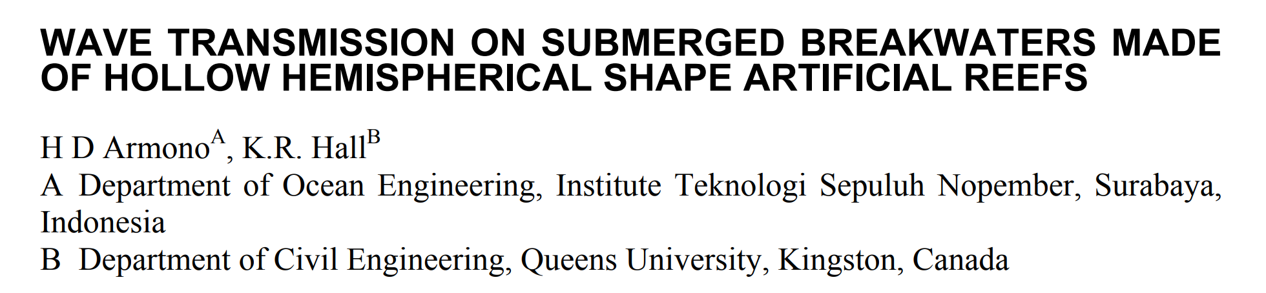
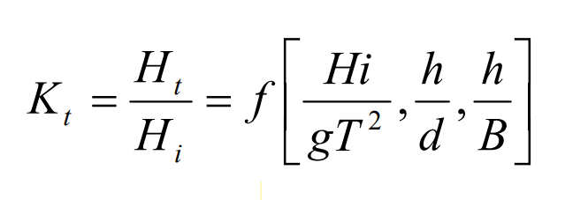
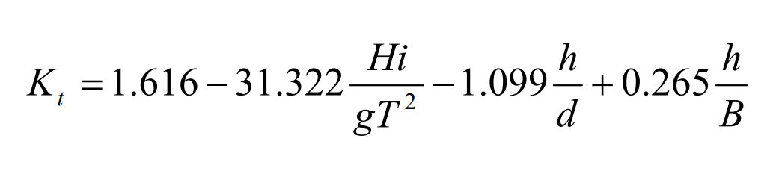
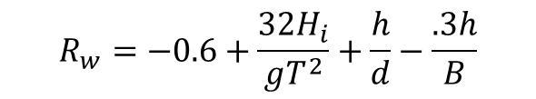
Wave Propagation
Armono, H. (2003). Wave transmission on submerged breakwaters made of hollow hemispherical shape artificial reefs. Proceedings, Annual Conference - Canadian Society for Civil Engineering. 2003.
Transmission Coefficient
At Stratford Pt.
h/B =.7/10=0.07 is a constant
h/d varies from 0.75/0 to 0.75/2.5
Lab-based Empirical formula
$$R_{w}=−0.6+\frac{32H_{i}}{gT^{2}}+\frac{h}{d}−\frac{.3h}{B}$$

Slide 5
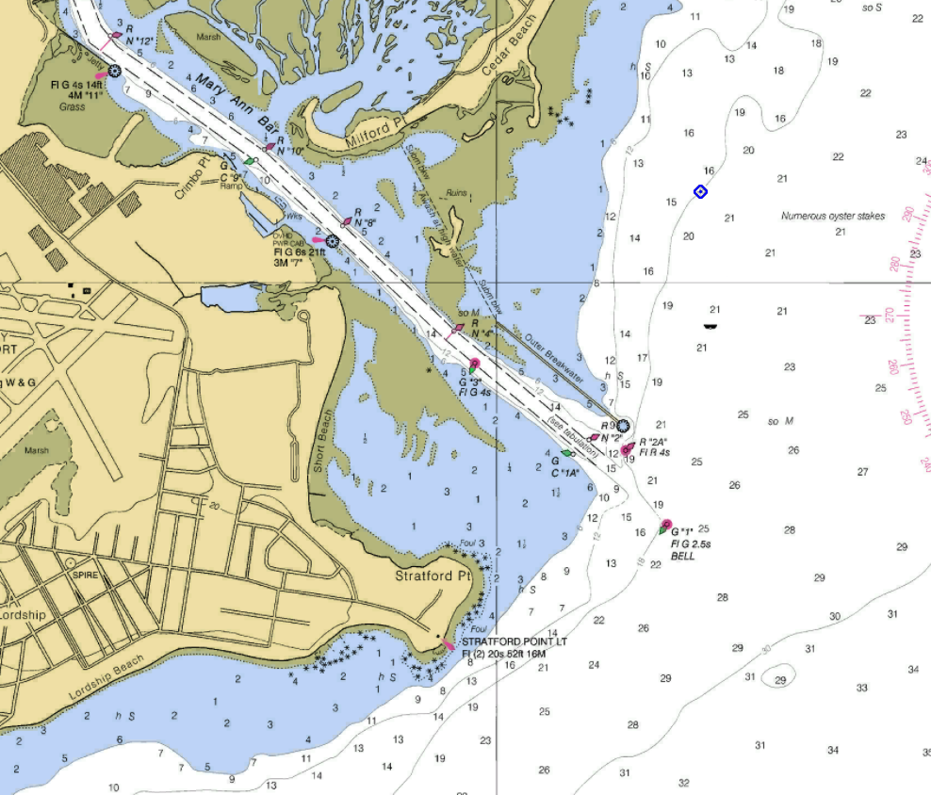
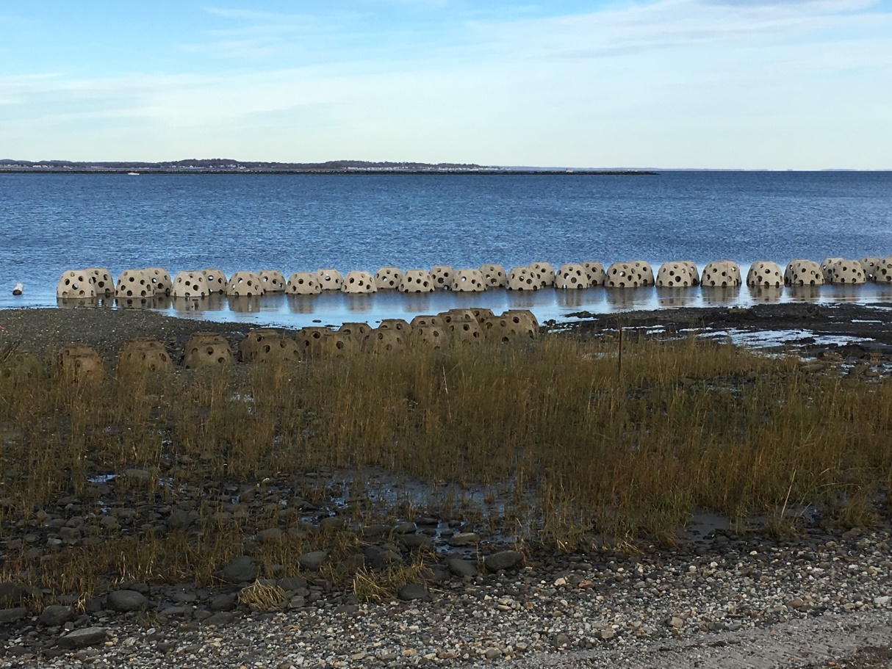

Wave Sensor Location
https://www.sacredheart.edu/
Study Area
Figure 1(a). A map of the entrance to the Housatonic River, CT, showing the location of the study area (red rectangle) to the west of Stratford Point and the long-term wave sensor (red circle) to the northeast. Note the location of the outer breakwater. Depths shown are in feet relative to mean low, low water (MLLW), and the area shown in blue are less then 6 ft deep. From NOAA Chart http://www.charts.noaa.gov/PDFs/12370.pdf

Slide 6
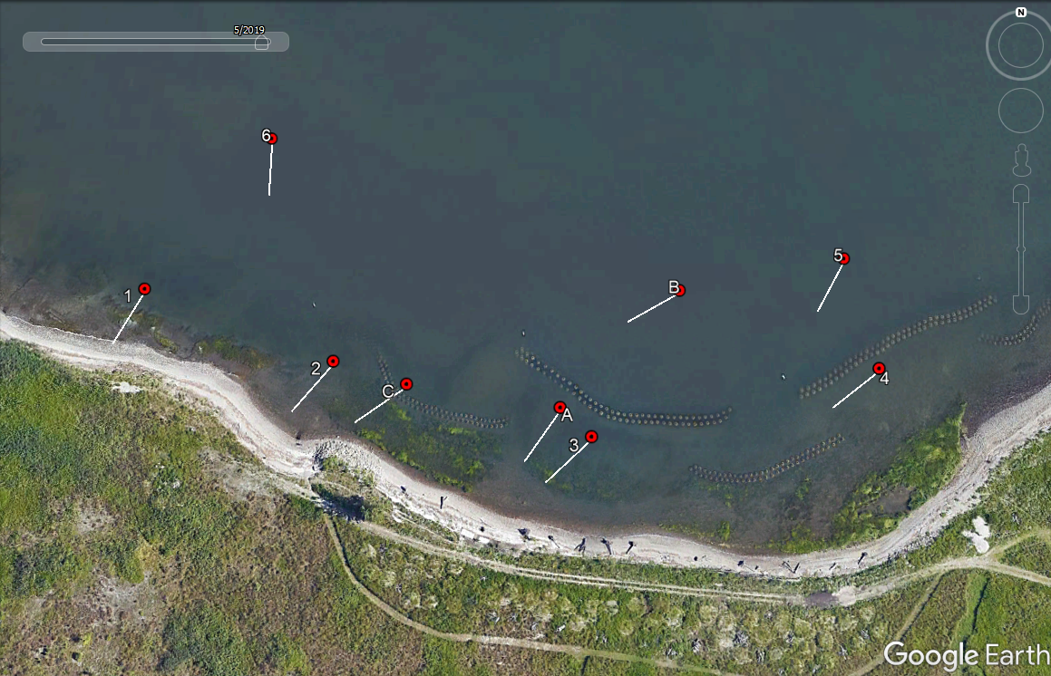
(b) GoogleEarth aerial image of the study area taken on May 31, 2019, approximately three weeks after the end of the spring study. The red circles show the location of the instruments, and white lines show the median direction of waves at the dominant period. The lines are all 20m in length. The arrays of reef balls are evident as parallel rows of small (~1m diameter) circles.

Slide 7
Transmission Coefficient
High tide
Low tide
Relative Depth

Slide 8
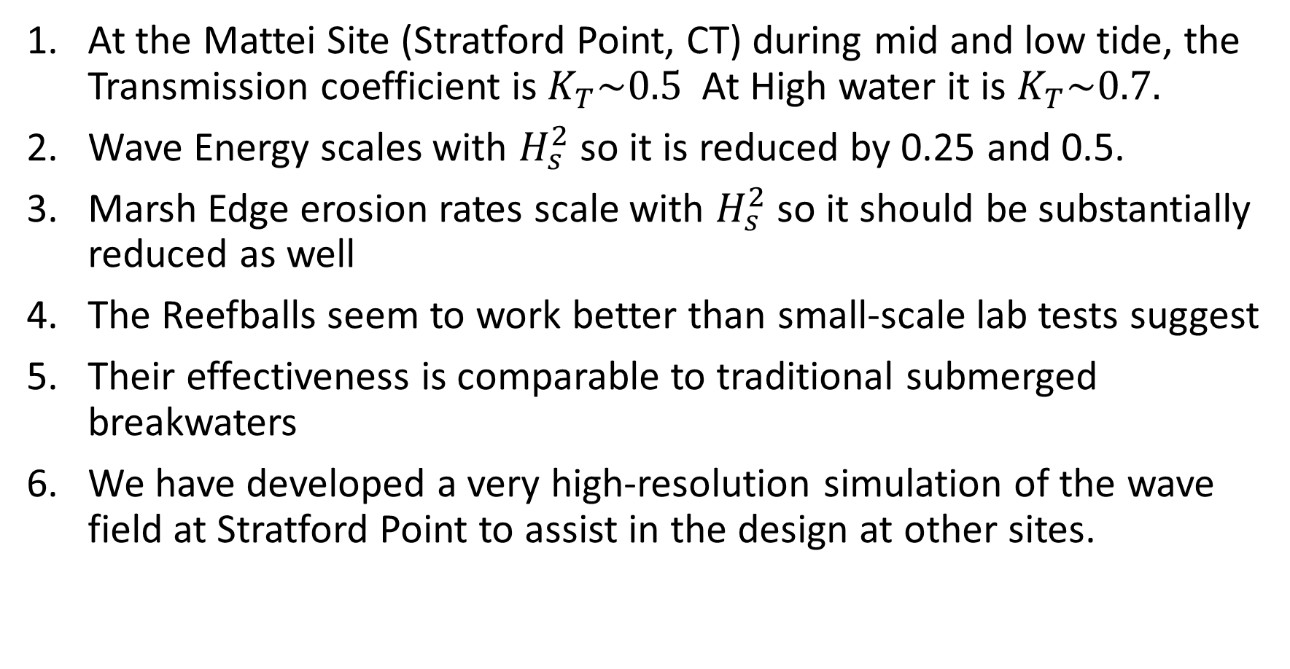
Summary
At the Mattei Site (Stratford Point, CT) during mid and low tide, the Transmission coefficient is $K_{T}\sim 0.5$ At High water it is $K_{T}\sim 0.7.$
Wave Energy scales with $H_{s}^{2}$ so it is reduced by 0.25 and 0.5.
Marsh Edge erosion rates scale with $H_{s}^{2}$ so it should be substantially reduced as well
The Reefballs seem to work better than small-scale lab tests suggest
Their effectiveness is comparable to traditional submerged breakwaters
We have developed a very high-resolution simulation of the wave field at Stratford Point to assist in the design at other sites.

