Slide 1
Incorporating ecological principles into coastal natural and nature-based features
Dr. Rachel K. Gittman
Department of Biology
Coastal Studies Institute

Slide 2
The Need: NNBF Designs and Substrates that Maximize Coastal Protection and Ecological Functions
Designing for oysters
Designing for waves
% wave attenuation
Morris et al. 2019
Notes:
These figures from that paper illustrate this tradeoff. Essentially if the goal of a project is to stabilize a landward shoreline, you can either design for oysters, or design for waves. If you design at an elevation in a configuration which will promote oyster settlement and growth, ideally wave attenuation and therefore stabilization benefits will increase over time as oysters settle and grow.
However, if you design a reef purely to serve as a wave attenuation device, oysters will recruit and grow only at the areas which are suitable, and over time the protective benefits will level off, given oyster growth wont be helping the structure grow in response to sea level rise. There is therefore a critical need to investigate alternative reef substrates, which overcome the challenges of performing in high energy, stressful sites, while also serving as successful oyster reefs.
12

Slide 3
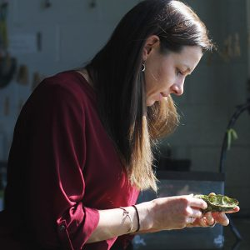
NNBF Implementation: Evaluating Baseline Conditions
Photo Credit: B. Puckett
How can we improve NNBF outcomes?
Keller et al. 2019 Restoration Ecology

Slide 4
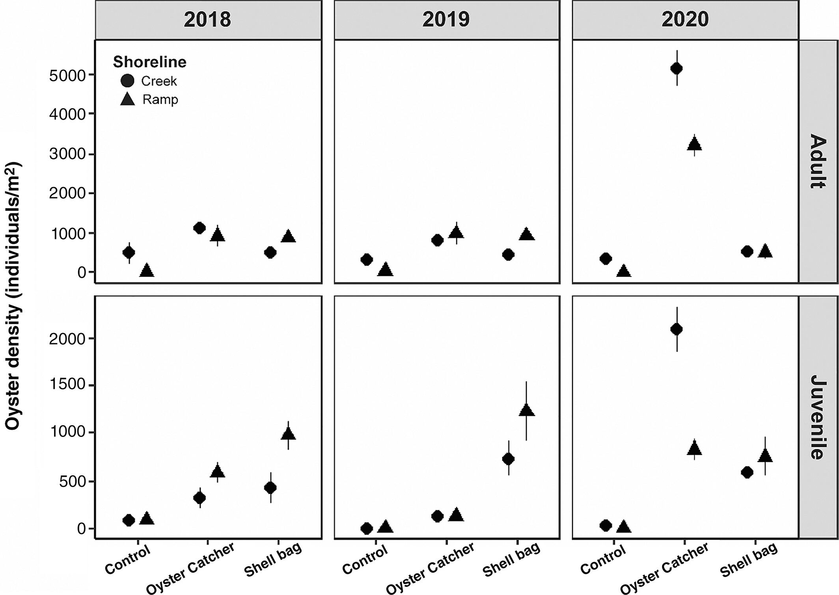
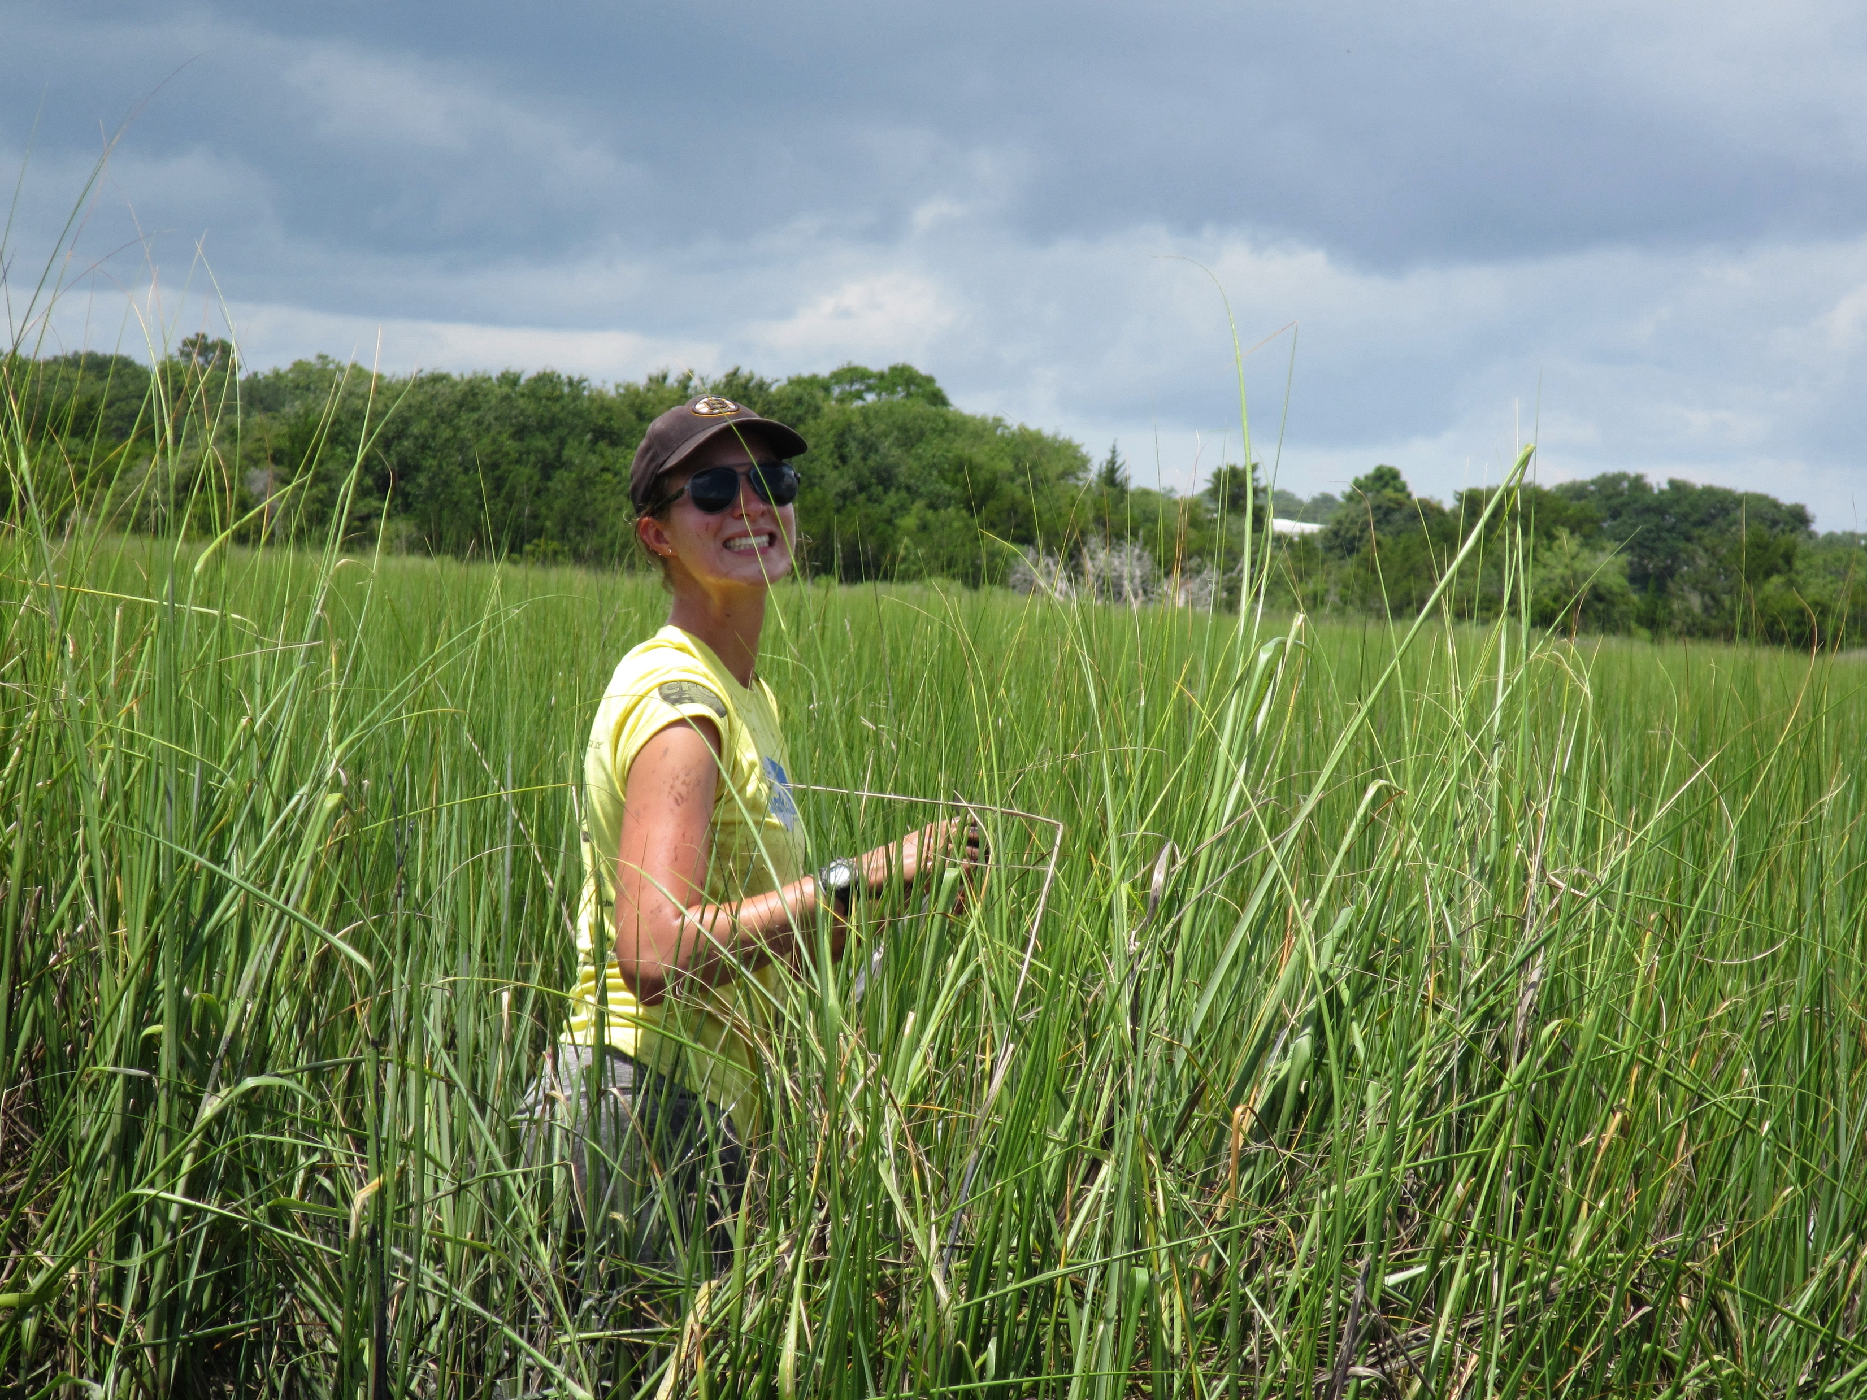
Oyster Catcher™
Novel Substrates
Shell Bags
Wellman et al. 2022 Ecological Applications

Slide 5
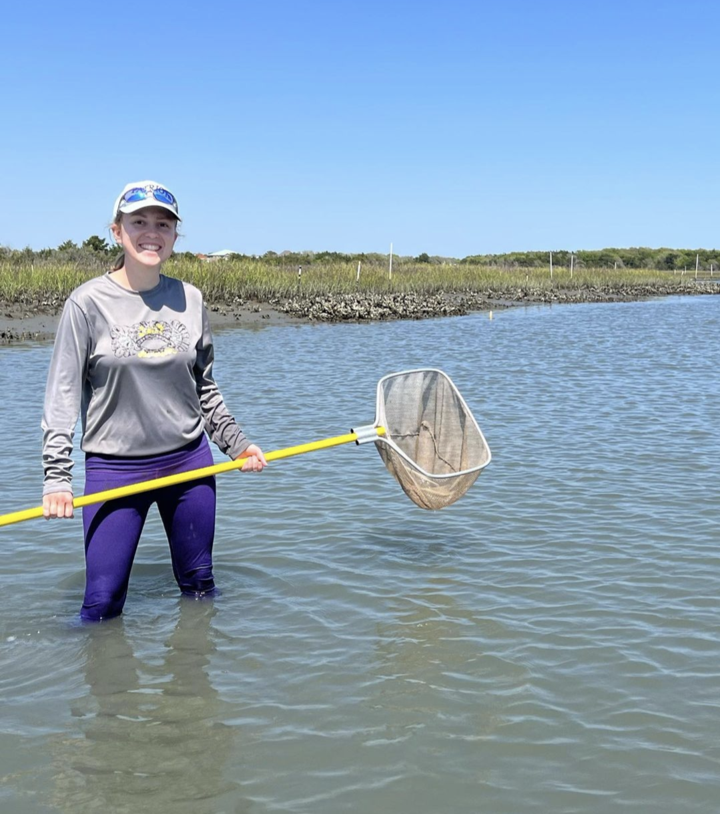
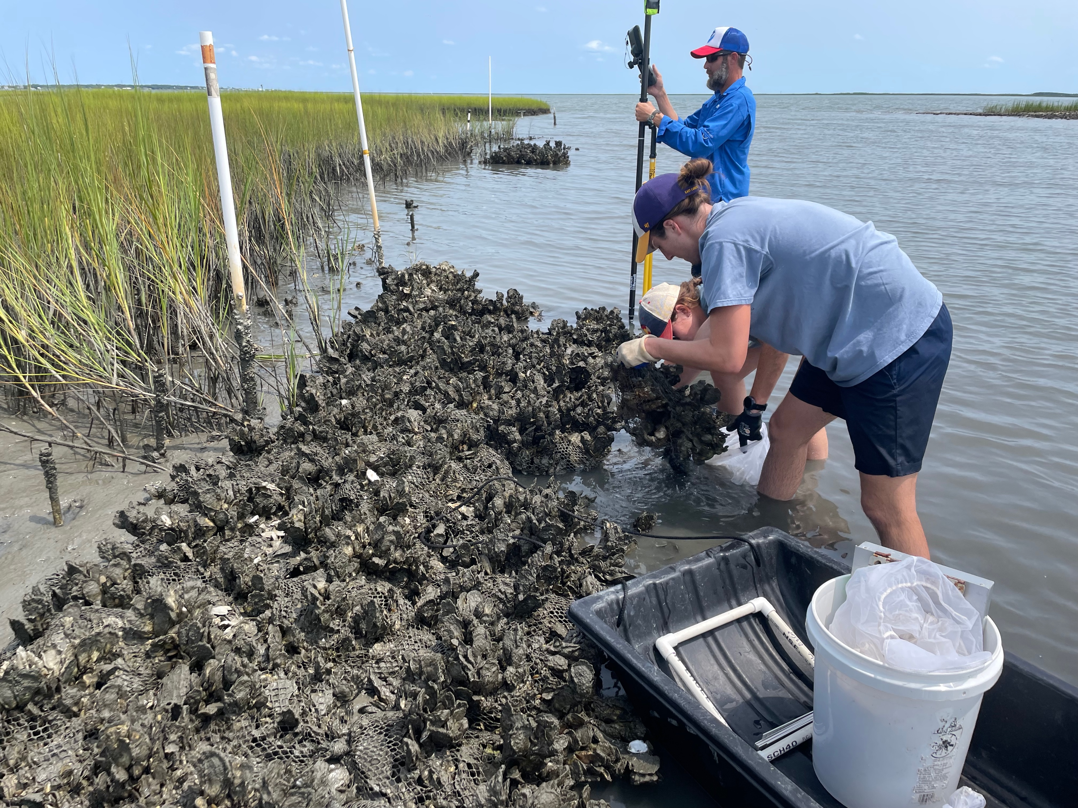
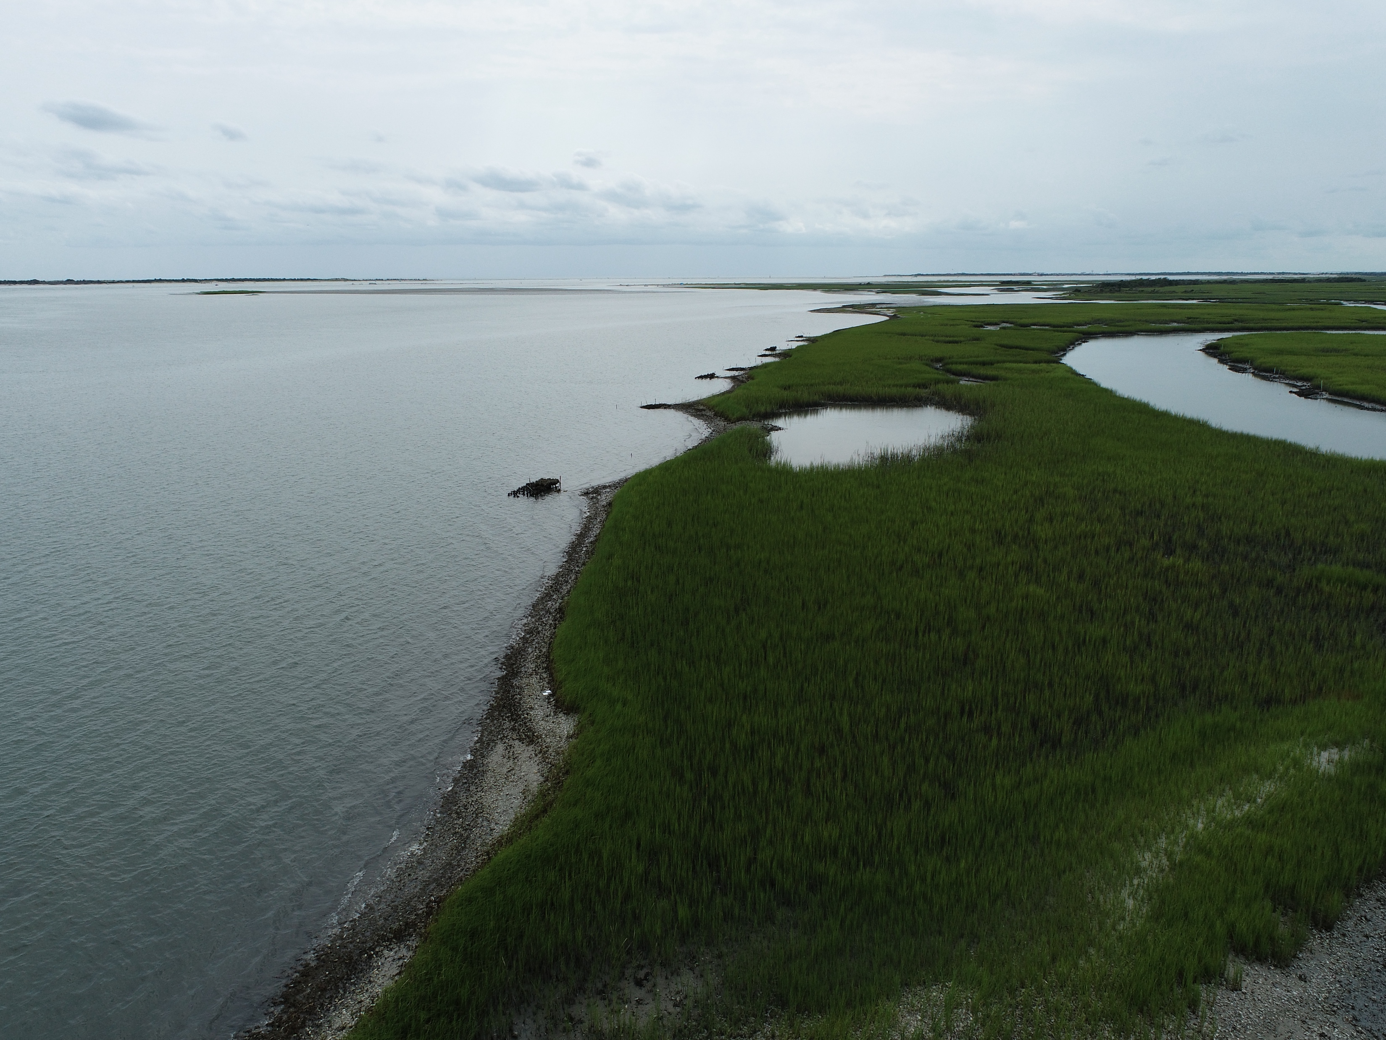
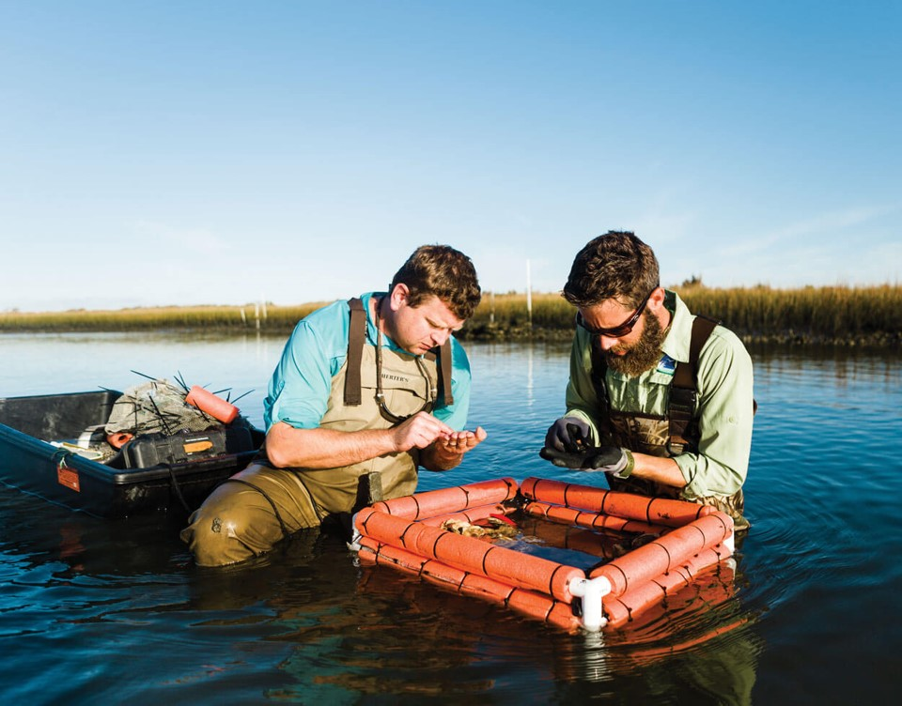
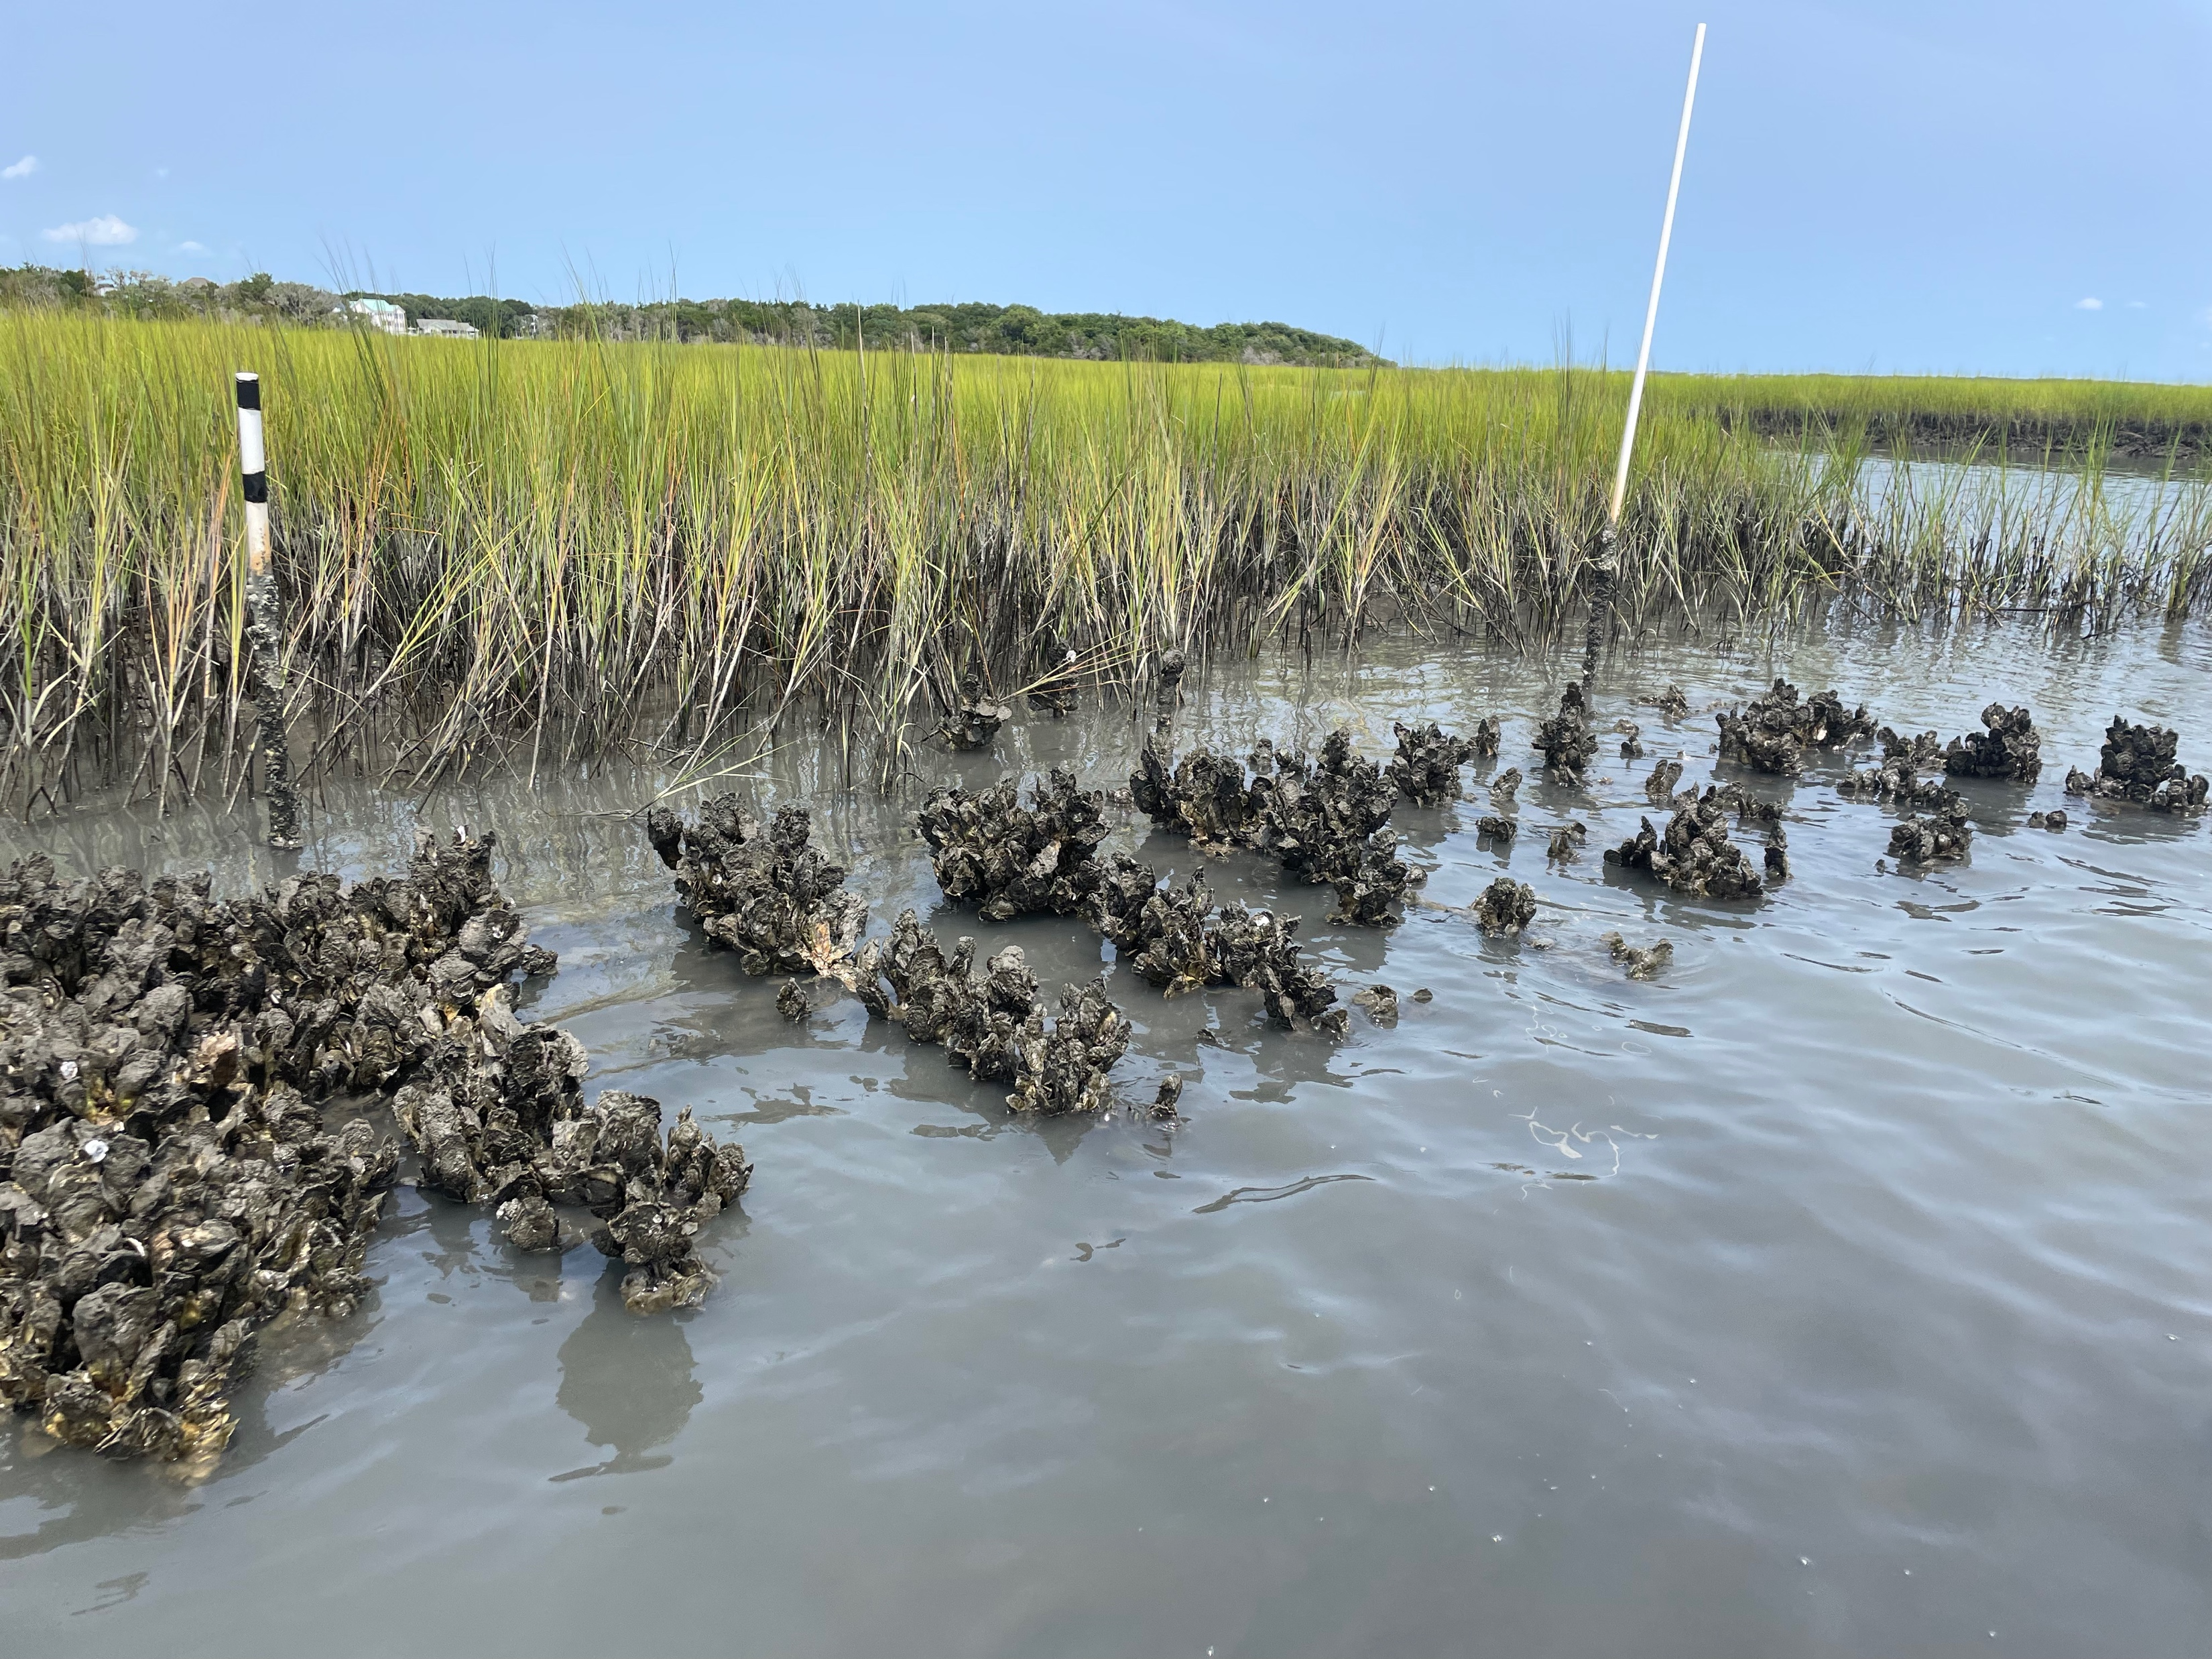
Long-term resilience to sea level rise?
Rodriguez et al. 2014 NCC
Photo Credits: A. Blakeslee and R. Gittman

Slide 6
Questions?

